Slide 1

Climate Detectives: Outdoor Learning & Media Literacy Project
Notes:
Pupils work in small groups (split class into 5 groups)
Each group is given: A map of stations (school grounds)
A recording booklet
Rotate every 20 minutes Total: 2.5 hours

Slide 2
Session Objectives
Understand what Climate Change is and what causes it
Use evidence to interpret climate data and information
Evaluate whether media sources are reliable or biased
Identify ways to reduce carbon impact and take action locally

Slide 3
















Information Sources
Think about where YOU get your information.
Phone or tablet
Family
TV and films
Magazines
Podcasts
Books
Computer
Newspapers
Theatre or
cinema
Music
News
Social Media
School
Adverts
Talking to people
Games
Notes:
Circle all the ways you regularly get information on the board as a class

Slide 4

Look for CLUEs
Not all media is completely trustworthy. There’s lots of reasons people might lie or exaggerate the truth online.
Looking for ‘CLUE’s will help you decide whether things you see online are real or not.
Comments
Is this person just posting to get comments, likes or attention? Check the comments! Often if the information is fake, someone might have said so.
Left out
Have they left out any information that might be important? Did they show you all the information or just pick out the bits that help them?
Ulterior
motives
What is the author trying to make you believe? Why have they written this? Is there something extra they want from you?
Evidence
Can you check that what they are saying is true? Are their ‘facts’ backed up with proof? Have they told you where they got their information from?

Slide 5
Climate Detective Task
Your task is to move around 5 different stations and use CLUE to help you complete the activities.
You will be working in small groups to do this.
You will need:
A resource book
A pencil
A clipboard or something to lean on
Stopwatch (Station 4)
Thermometer (Station 5)
Be aware, take great care—fake news is everywhere!

Slide 6
Follow-Up
Station 1
Climate Change
Which post was based on real information?
🌍 Post A
🌍 Post B
“Climate Change is already having serious impacts on our planet.
The International Panel of Climate Change states that global temperatures have risen by around 1.1°C since the late 1800s, mainly due to human activities like burning fossil fuels.
Atmospheric CO2 levels are the highest in at least 800,000 years.
We are seeing real effects:
More frequent extreme heatwaves
Rising sea levels (20 cm since 1900)
Increased risk of flooding and wildfires
Scientists across the world agree that urgent action is needed.”
“Global warming is made up and nothing to worry about.
The climate has always changed, so humans can’t be causing it.
Cold weather proves that warming isn’t happening.
Climate scientists just want funding and attention.
Switching to green energy is too expensive and doesn’t work anyway. We should continue to burn fossil fuels.”
Copyright © 2026 BBC

Slide 7
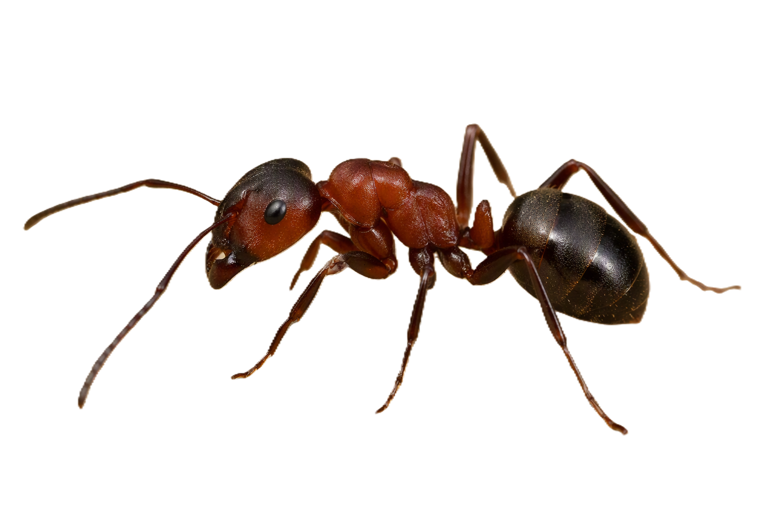
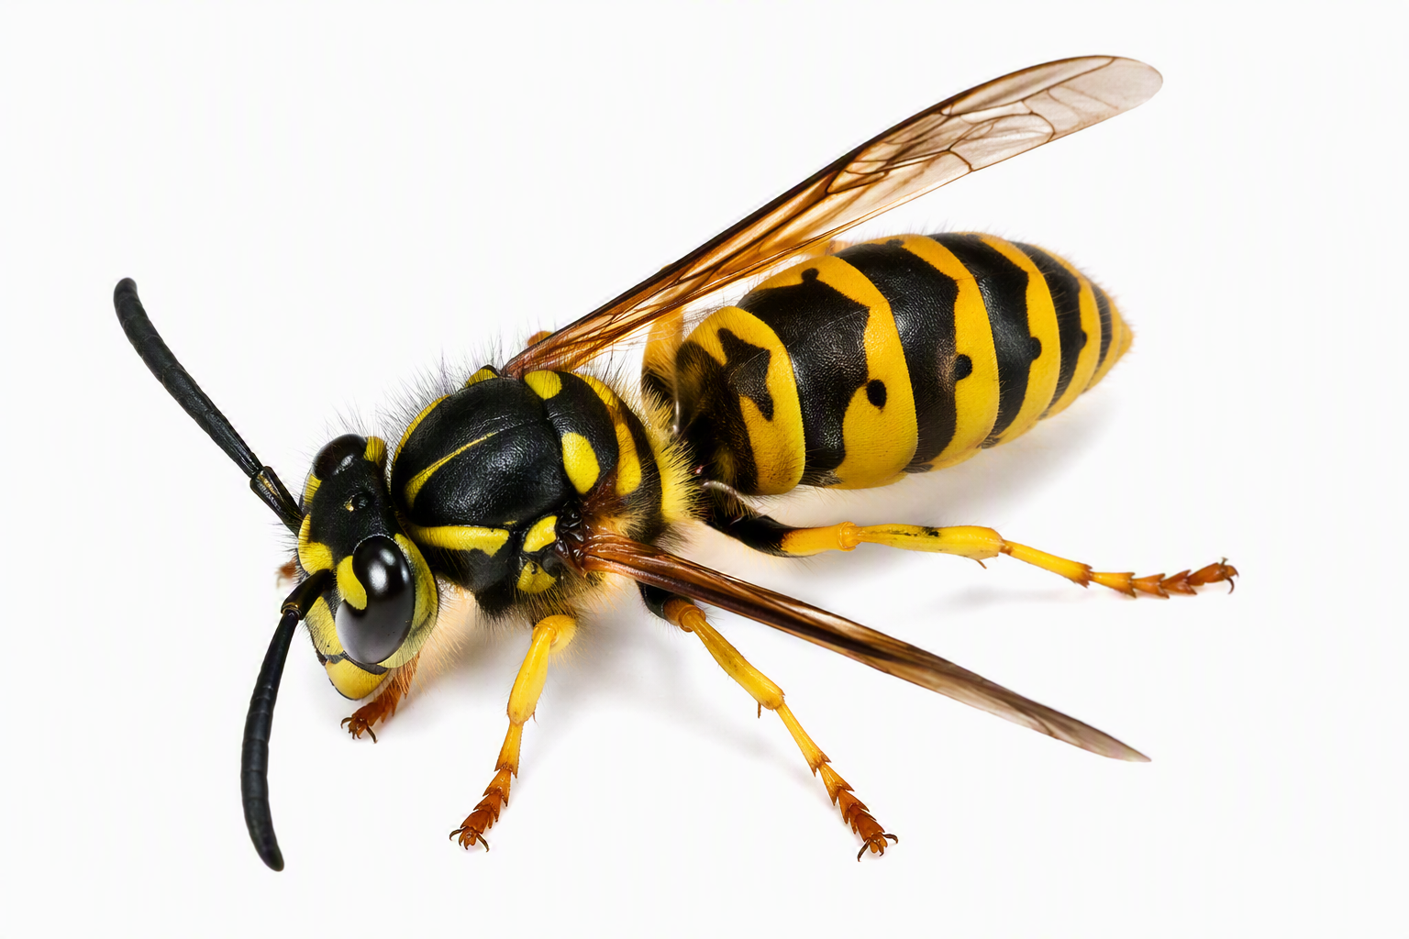
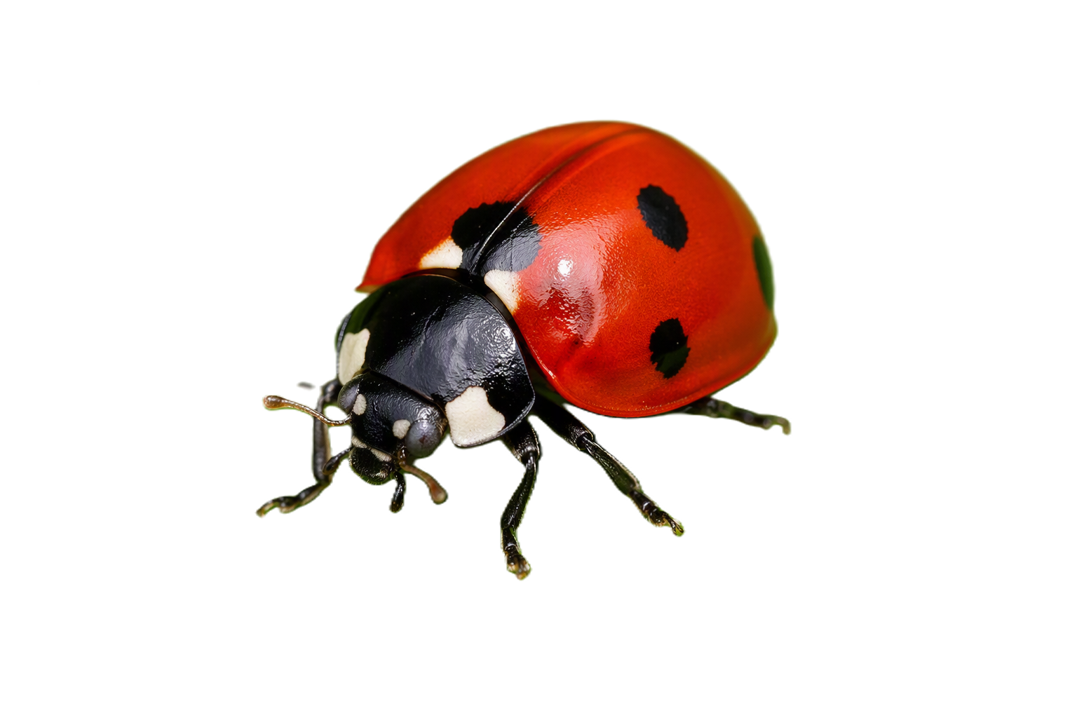
Follow-Up
Station 2
Clickbait
Were you drawn in by these headlines? Did you believe them?
Share your Clickbait
🐞 “Ladybirds are red because they bite humans and drink blood - experts shocked!”
🐜 “Ants secretly planning to take over gardens this summer!”
🐝 “Killer bees invade UK garden - scientists warn it’s too late to stop them!”

Slide 8
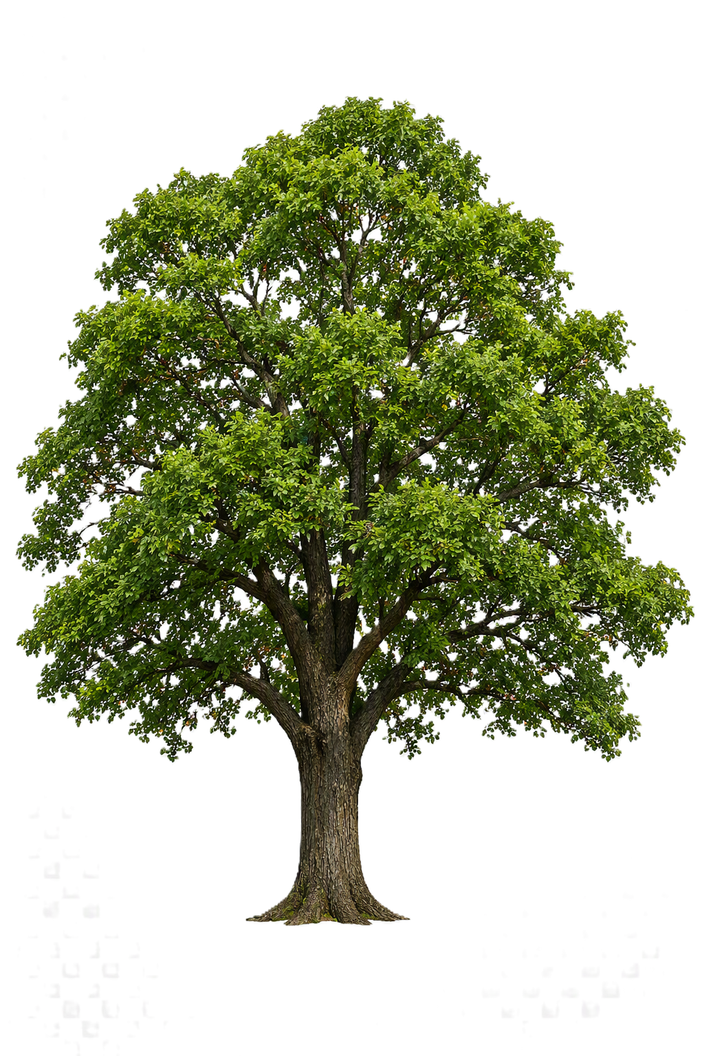
Follow-Up
Carbon Footprint
Station 3
Share your Videos
Mobile Phone
Task:
Which stage has the biggest impact?
Why is making the phone so carbon heavy?
How could you reduce your impact?
How many trees do you have at your school?
How trees would be needed to absorb the impact of everyone in your class having a phone for 1 year?

Slide 9
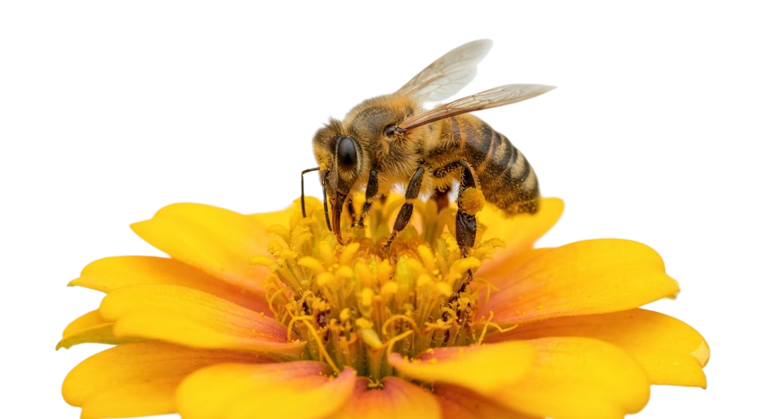
Follow-Up
Pollinator Power!
Station 4
Share your results!
Which areas had more pollinators?
What could we do as a school to attract more pollinators?

Slide 10
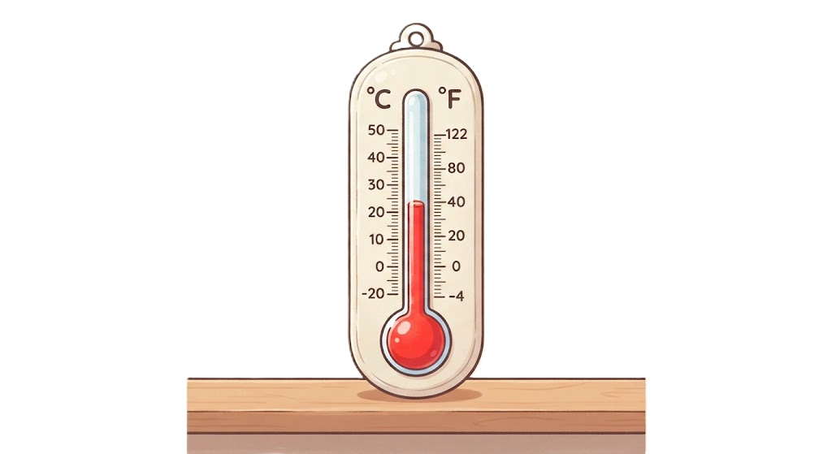
Follow-Up
Microclimate Measuring
Station 5
Share your results!
Which areas were hottest?
What could we do as a school to keep areas cooler?

Slide 11
Climate Detectives – What have we learnt?
Understand what Climate Change is and what causes it
Use evidence to interpret climate data and information
Evaluate whether media sources are reliable or biased
Identify ways to reduce carbon impact and take action locally

Slide 12
Climate Detectives – My Pledge
I will avoid fake news by:
I will help the climate by:

