Slide 1



Station 1
Climate Change
Use CLUE to figure out which is fake news:
🌍 Post A
“Climate Change is already having serious impacts on our planet.
The International Panel of Climate Change states that global temperatures have risen by around 1.3°C since the late 1800s, mainly due to human activities like burning fossil fuels.
Atmospheric carbon dioxide levels are the highest in at least the past 800,000 years.
We are seeing real effects:
More frequent extreme heatwaves
Rising sea levels (20 cm since 1900)
Increased risk of flooding and wildfires
Scientists across the world agree that urgent action is needed.”
🌍 Post B
“Global warming is made up and nothing to worry about.
The climate has always changed, so humans can’t be causing it.
Cold weather proves that warming isn’t happening.
Climate scientists just want funding and attention.
Switching to green energy is too expensive and doesn’t work anyway. We should continue to burn fossil fuels.”

Slide 2
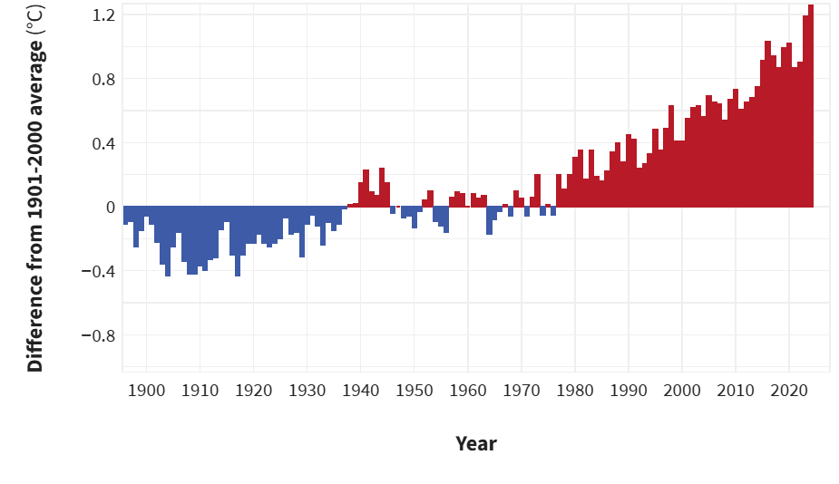
Station 1
Climate Change
This graph shows global average surface temperature:
NOAA Climate.gov graph, based on data from the National Centers for Environmental Information.
Can you recreate this graph using natural resources such as sticks and leaves?
When was the last time the global climate was colder than the average temperature? (Hint: Colder years in blue)
Make sure you use a different material to show this point!

Slide 3
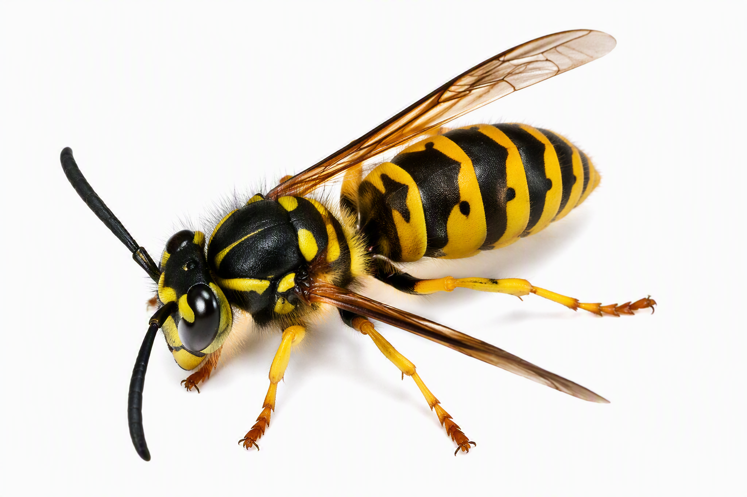
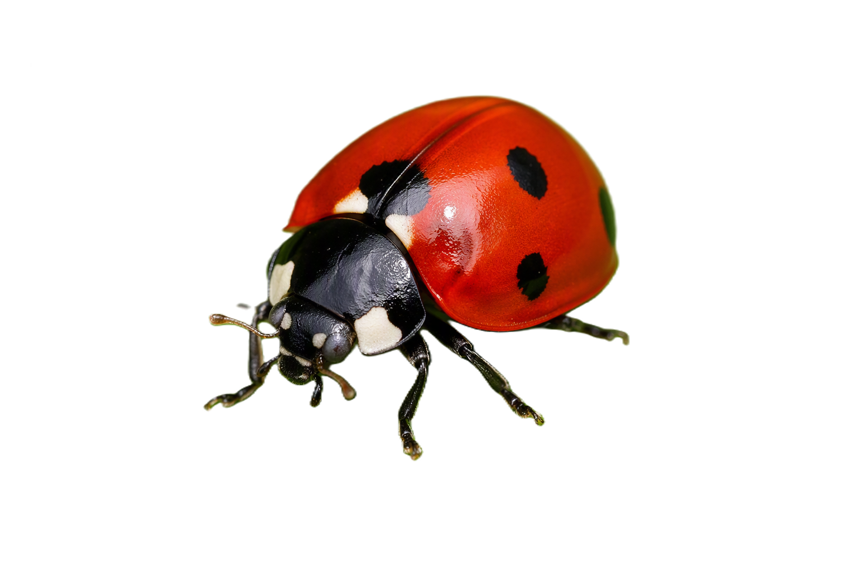
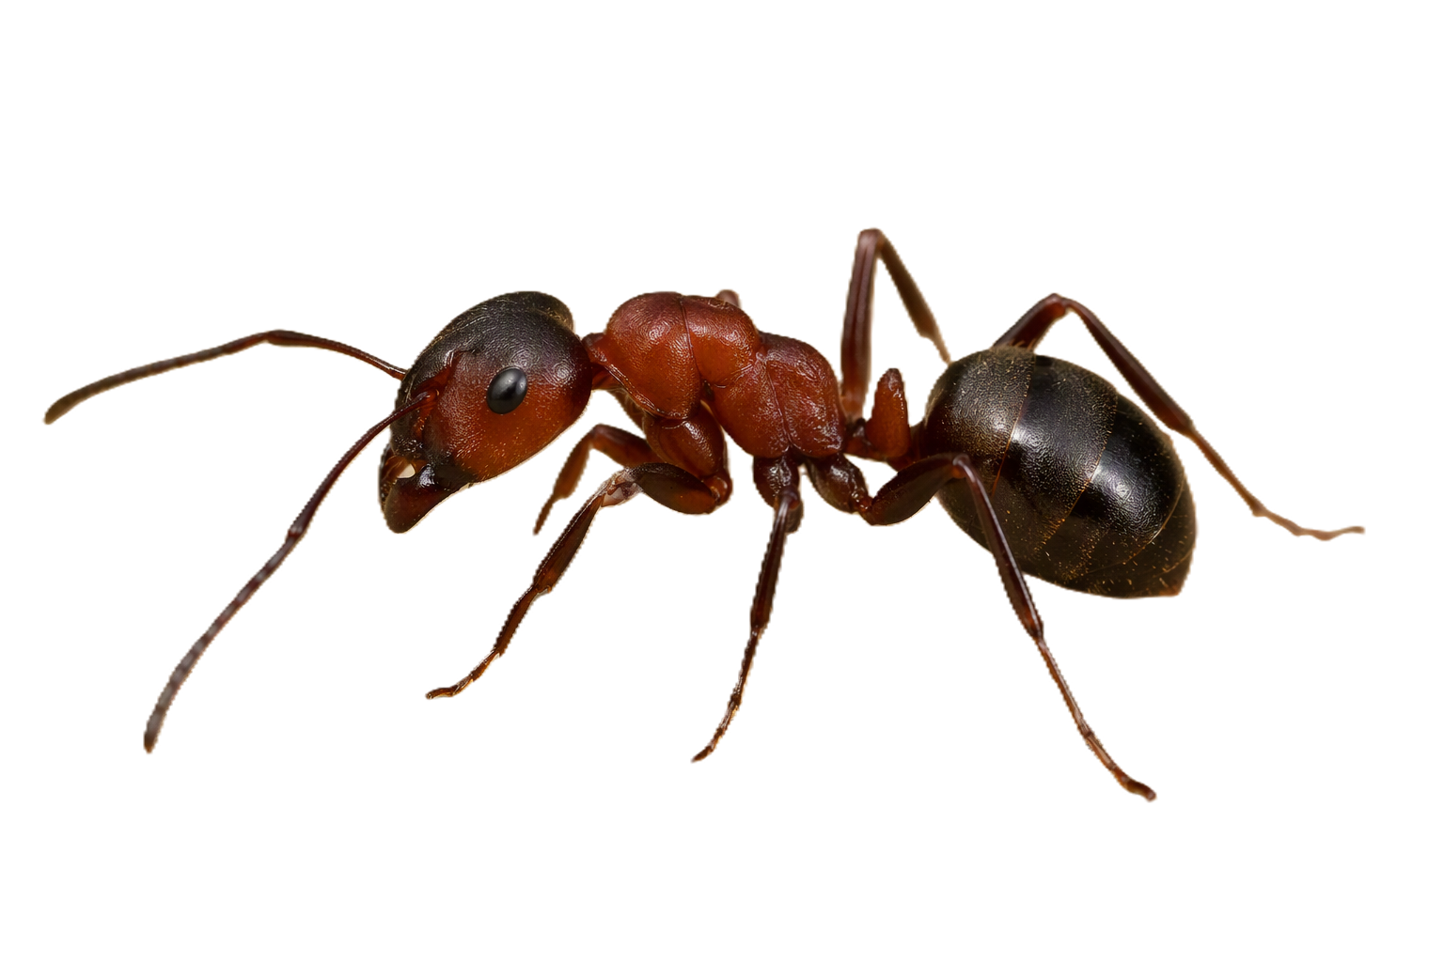
Station 2
Clickbait
Often people will use fake or outrageous headings to get people to click on their posts.
Take a look at these; do you believe these headlines?
🐝 “Killer bees invade UK gardens - scientists warn it’s too late to stop them!”
🐞 “Ladybirds are red because they bite humans and drink blood - experts shocked!”
🐜 “Ants are secretly planning to take over gardens this summer!”
Now spend 5 minutes looking for insects and draw one you find. Create a clickbait headline of your own!

Slide 4
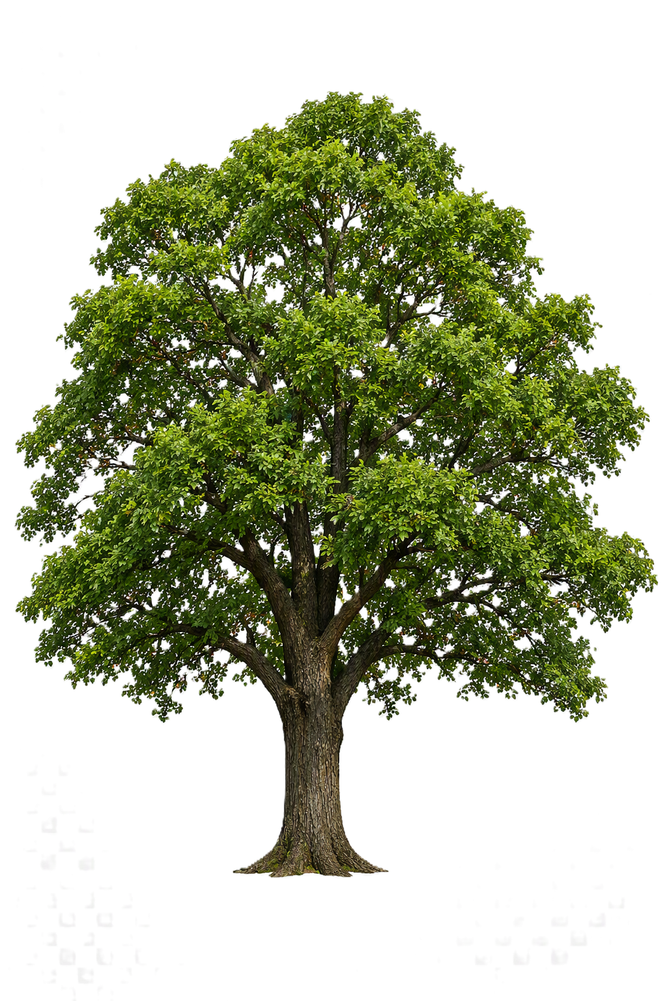
Station 3
Carbon Footprint
Work in your group to calculate the carbon impact of a mobile phone.
Which stage has the biggest impact?
Why is making the phone so carbon heavy?
How could you reduce your impact?
Stage | Carbon Impact
Making the phone | 95 kg CO2
Charging for 1 year | 1 kg CO2
Data Use (apps, streaming) 1 year | 15 kg CO2
Shipping and Packaging | 10 kg CO2
A mature, fully grown tree absorbs about 22 kg of carbon dioxide (CO₂) per year.
How many trees do you have at your school?
How many trees would it take to absorb the impact of everyone in your class having a phone for a year?
Create and record a 1–2-minute video of the carbon impact of a phone and how your school can plant trees to help.

Slide 5
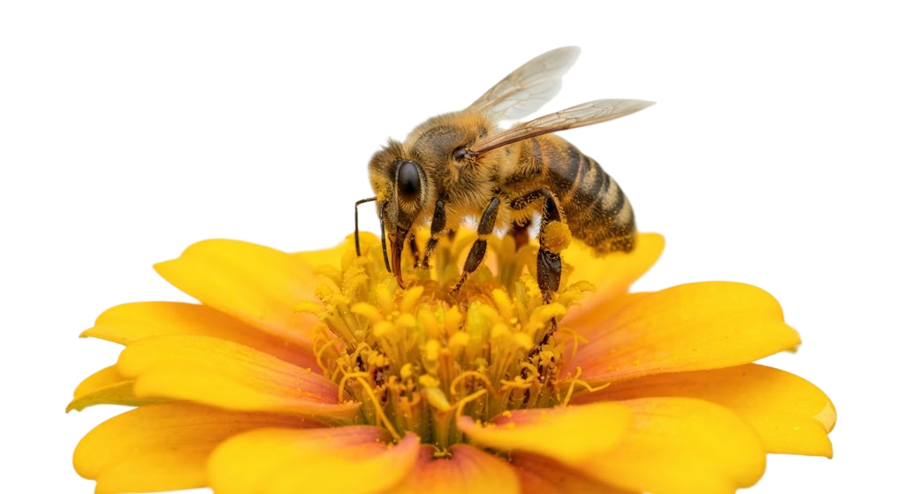
Station 4
Pollinator Power!
What is a pollinator?
A pollinator is an animal that helps plants make seeds by moving pollen from one flower to another.
When a bee, butterfly, or other insect visits
a flower to collect nectar, pollen sticks to its
body.
When it visits another flower, it transfers
the pollen, helping plants grow fruits and seeds.
Pollinators help:
🌱 Plants grow (including many crops we eat)
🍎 Produce food like fruits, vegetables, and nuts
🌻 Maintain biodiversity (different plants and animals)
🌎 Support healthy ecosystems
Climate change can:
🌡️ Change when plants flower
⏰ Disrupt timing between insects and plants
🌧️ Increase extreme weather (heatwaves, flooding)
🌿 Reduce habitats and food sources
Without pollinators, many plants would struggle to survive - and so would animals (including humans).
Task:
Create a map of your school and add on the areas where you have flowers.
Using an area of playground and an area with flowers, tally how many pollinators you see.

Slide 6
Station 5
Microclimate Measuring
Different surfaces and environments heat up in different ways.
🌿 Grass and plants stay cooler
🧱 Concrete, Astroturf and tarmac get much hotter
🌳 Shade is cooler than direct sunlight
In a warming climate, these differences can:
Make some areas too hot for plants and animals
Create hot spots in cities and school grounds
Affect where insects (like pollinators) can survive
You are going to compare:
Sun vs Shade
Grass vs Concrete
Steps:
Go to your first location
Hold a thermometer just above the surface
Wait 30–60 seconds
Record the temperature

