Slide 1


Climate Media Detectives
Key vocabulary
Draw lines to match the words up with their meaning.
Emissions |  | Something that can be trusted or depended on.
Source |  | Change over time of the weather patterns and average temperatures of the whole planet.
Bias |  | When opinions change how you or someone thinks about something, making it hard for you or them to be fair.
Greenwashing |  | Where your information comes from.
Reliable |  | When organisations and companies try to look more environmentally friendly than they actually are.
Climate Change |  | Gases and pollution released by humans through cars, factories and lots of other things.

Slide 2





Activity 1
Motivation Detectives
Have a look at the 5 sources, and the 5 possible authors. Who do you think made each one? Why do you think they made it? What do they want you to do or think?
Lukas is a 22 year-old social media influencer. His family owns an oil business. | Anna works at a local shop. She likes to post things online that will get lots of comments. | The Clifftown Trust have been looking after the local sea cliffs for nearly 100 years. Lots of tourists come to see the area. | Saffiyah works at a research laboratory. This study was paid for by a company that makes petrol cars. | Newsround is a BBC news programme. They aim to share world news in a way that is easier for children and young people to understand.
Source | Who wrote it? | Why?
1
2
3
4
5

Slide 3
Activity 2
Data Detectives
Look at the information and see if you can work out what’s missing, or how this information is trying to trick you.
 | What are they telling you? | How are they tricking you?
1
2
3
4

Slide 4
Activity 3
Fact Detectives
Is the statement below fact or opinion? Use what you have practiced to help you decide and then label the statement to show how you decided.
“The salt marsh growing in Morecambe Bay is ugly and scruffy, the council should get rid of it.”
Activity 4
Undercover Detectives
Use this space to make your plans! How will you trick people into believing your media?
Notes:
You may want to skip this page and just have students do the activities without recording

Slide 5
Fact Detectives
Activity 3 – Sorting table
Sort the cards into the right column
Fact | Opinion

Slide 6
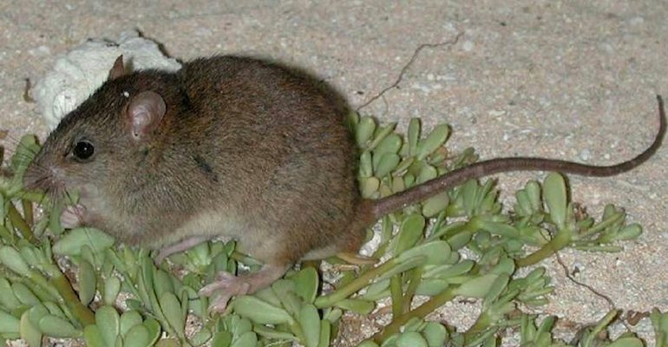
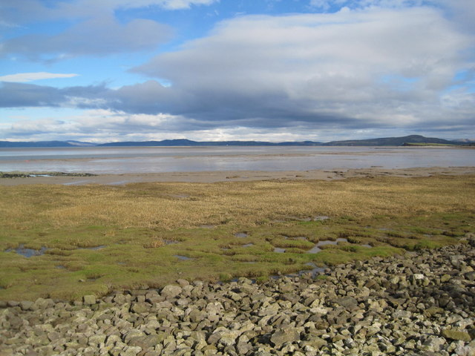
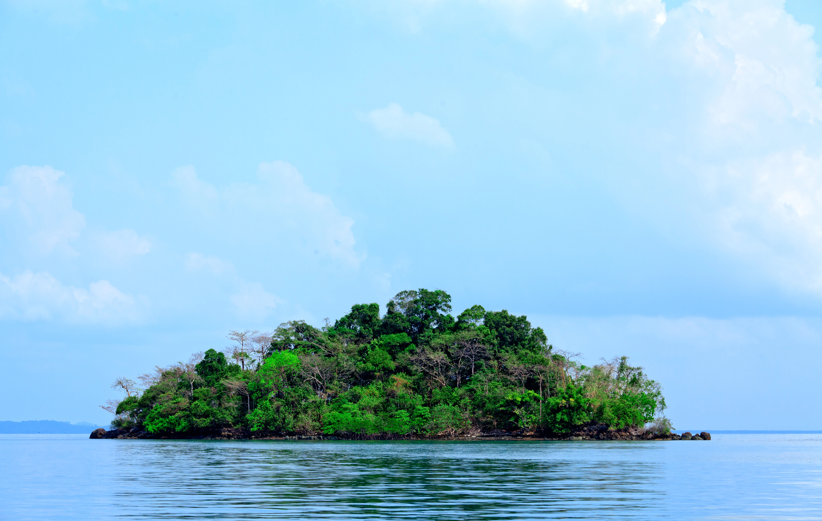
Activity 3 – Cards for sort
Wind turbines are good, but shouldn’t be built here because they will destroy the view completely. | There are approximately 11,000 wind turbines currently active around the UK. | It’s OK that they fly everywhere in a private jet because they also plant lots of trees to help the environment.
The Bramble Cay Melomys was declared extinct in 2019 when rising sea levels flooded the only small island it lived on. | The salt marsh growing in Morecambe Bay is ugly and scruffy, the council should get rid of it. | It doesn’t really matter if an animal I never heard of from a place I never heard of goes extinct. It doesn’t affect me.
I’m glad it doesn’t snow as much anymore. It messes the roads up and gets in the way. | The number of days over 30°C occurs more the 4 times more in London than it did in the UK climate 40 years ago. | Solar energy isn’t helpful, It rains too much here.
UK families can save around £500 a year on their electricity bill with solar panels on the roof. | Trains and buses are a waste of money, it’s easier to drive. | Travelling by train instead of car would produce 75% less carbon emissions.
Notes:
Bramble Cay Melomys image: By State of Queensland, CC BY 3.0 au, https://commons.wikimedia.org/w/index.php?curid=49457717
30C days – State of the UK Climate report 2025
Solar panel savings: https://www.gov.uk/government/news/homeowners-could-save-hundreds-on-energy-bills-from-solar-drive
Morecombe Bay picture – Field Studies Council

Slide 7
Activity 5 – Choice Detectives
Put the cards in the right columns on the sheet. What total carbon footprint did you get for each bag?
Which bag would you buy and why?
________________________________________________________________________________________________________________________
Design your new school bag below!
Bag A | Bag B

Slide 8
Compare the Two Backpacks
Activity 5
Put the correct values in each column and add up at the bottom
 | Company A | Company B
Material Production
Transport of Materials
Manufacturing
Transport to shop
Packaging
Total Carbon Footprint

Slide 9
Round Up
What have you learned from each of the activities?
Activity | Top Takeaway
1
2
3
4
5
What is your first question you will ask when you hear new information about climate change?
Remember to look for CLUEs
Comments
Left Out
Ulterior Motive
Evidence
What is your top tip to help someone not fall for false information online?

