Slide 1

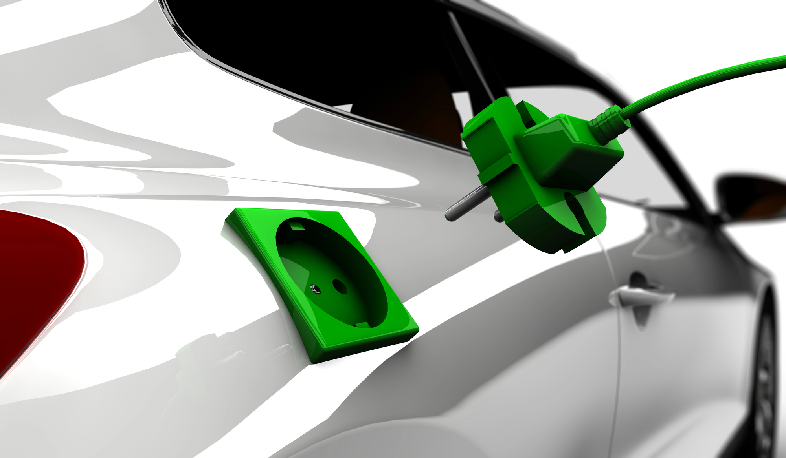

Activity 1 Source 1
Study results: Electric cars cause more pollution than petrol cars.
My research shows that cars produce more pollution from their tyres than from their exhaust fumes. As cars drive and wear down their tyres, they release tiny bits of rubber and other chemicals harmful to humans.
Because of their large batteries, electric cars are much heavier than petrol cars which means they wear down their tyres more. This will cause more rubber and chemical pollution than petrol cars, making them dangerous to everyone’s health.
Notes:
Teacher’s note: This is based on how some news companies reported on a 2022 study finding that petrol cars produced more pollution from wear and tear on their tyres than from their exhausts. The actual study only looked at petrol cars, and the argument that the increased weight of EVs meant they were overall more polluting was added by media outlets when reporting!

Slide 2

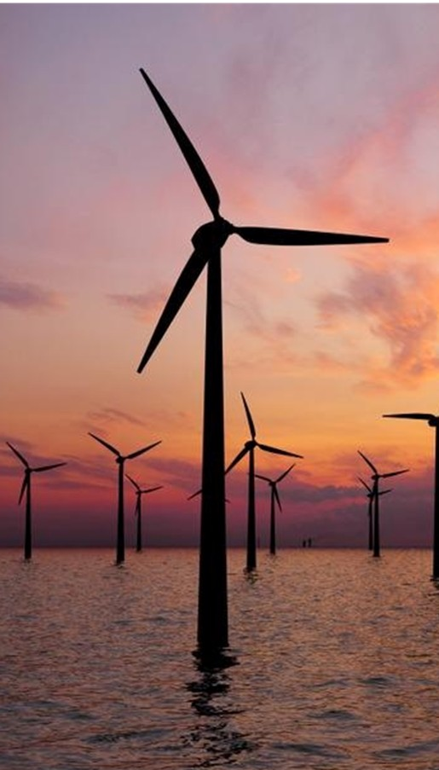
Activity 1 Source 2
WHY WILL NOONE ADMIT THAT WIND TURBINES ARE A HUGE PROBLEM
UGLY
DANGEROUS TO LIFE
KILL BIRDS AND FISH
WHAT DO THEY HAVE TO HIDE?

Slide 3
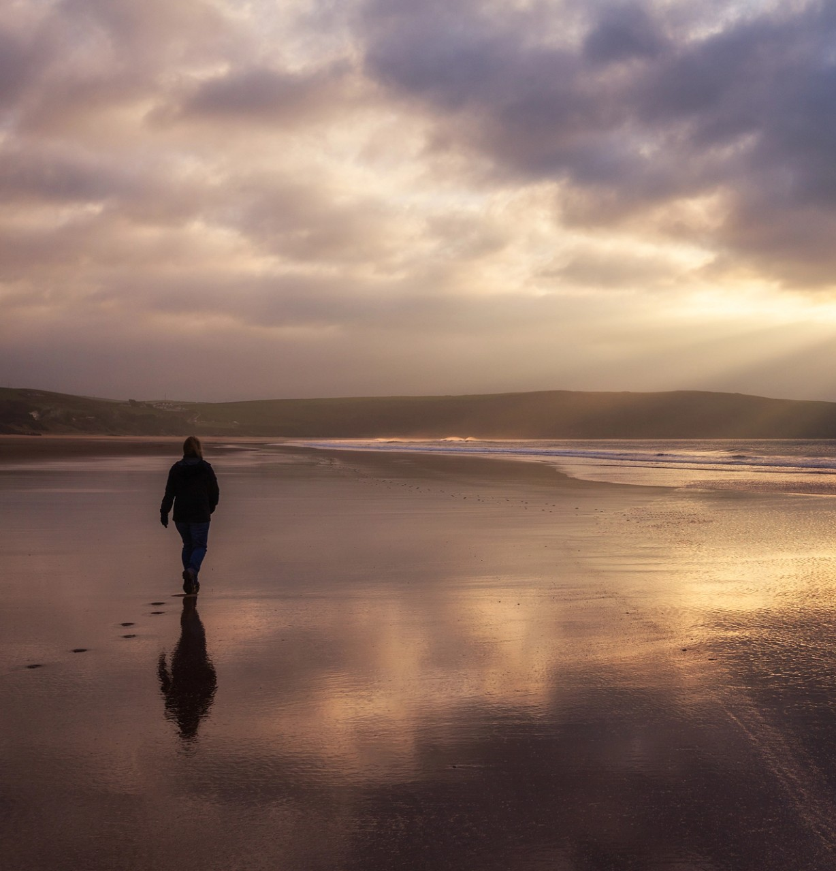


Activity 1 Source 3
NAME ON FB
50m.
OMG just heard that most of Beachtown is going to be underwater by the end of the year. The world is getting HOTTER and the sea is getting HIGHER and there are all these HUGE STORMS. Can’t believe I might lose my beautiful beach-side house.
I’VE LIVED HERE MY WHOLE LIFE, I’M NOT MOVING. FIX THIS @BEACHTOWN-MAYOR.
Like and share if you agree that we should save our lovely town from this DISASTER
🌅💖🌊🌊😢🤬

Slide 4

Activity 1 Source 4
Disappearing Puffins
Volunteers keeping track of puffin populations have raised the alarm on a steady decrease in numbers over the last few years. Since 2023, the number of puffins nesting at sites they survey has decreased by 10%. The same thing is happening in other areas of the country.
In fact, research by the British Trust for Ornithology* suggests that our British puffin population may decrease by 90% by the year 2050. The study suggests that this is because of climate change causing warmer seas, which then means there are fewer fish for the puffins to feed on.
*Ornithology means the study of birds
Notes:
Fictional article based on this study:
https://www.bto.org/our-work/science/publications/papers/seabird-abundances-projected-decline-response-climate

Slide 5
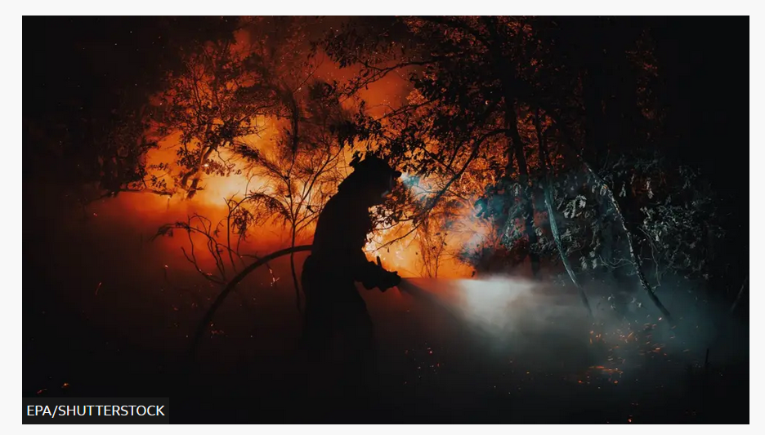
Activity 1 Source 5
Wildfires in Europe spark concerns around Climate Change
A firefighter battles a wildfire in Oímbra, Spain.
15th August 2025
Wildfires are continuing in several parts of Europe, with Spain and Portugal being the worst-affected countries.
Thousands of firefighters supported by soldiers and water-bombing aircraft battled over 20 major wildfires across western Spain on Monday.
Officials say a record area of land has already been burnt and thousands of people have been evacuated for their safety.
Fires have also broken out in parts of France, Greece, Turkey and the Balkans in Southeastern Europe. Climate change is making extreme heat in Europe more likely.
On Tuesday, the World Meteorological Organization (the United Nations' weather and climate agency) said people will need to learn to live with the new normal of extreme heatwaves, which will occur more often and be more intense.
Notes:
https://science.nasa.gov/earth/explore/wildfires-and-climate-change/
Article created with combining paragraphs from the following 2 newsround articles:
https://www.bbc.co.uk/newsround/articles/cdd3n9pvj6yo
https://www.bbc.co.uk/newsround/articles/c4g8q7dl9jro

Slide 6
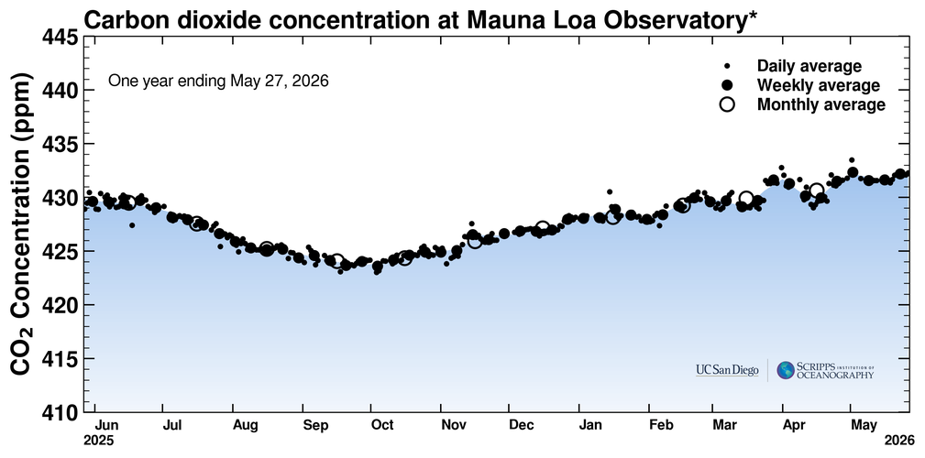
Activity 2 Source 1 (A)
Someone shows you this graph showing how much Carbon Dioxide gas was in the atmosphere over a year from May 2025 – May 2026.
They say:
“See, it’s totally normal for Carbon Dioxide levels to go up and down a bit, people are just being overdramatic.”
Is there anything you think they might not be telling you?
Notes:
All data taken from https://keelingcurve.ucsd.edu/

Slide 7
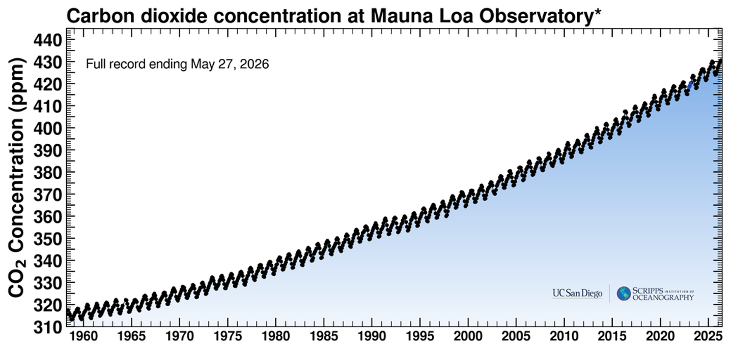
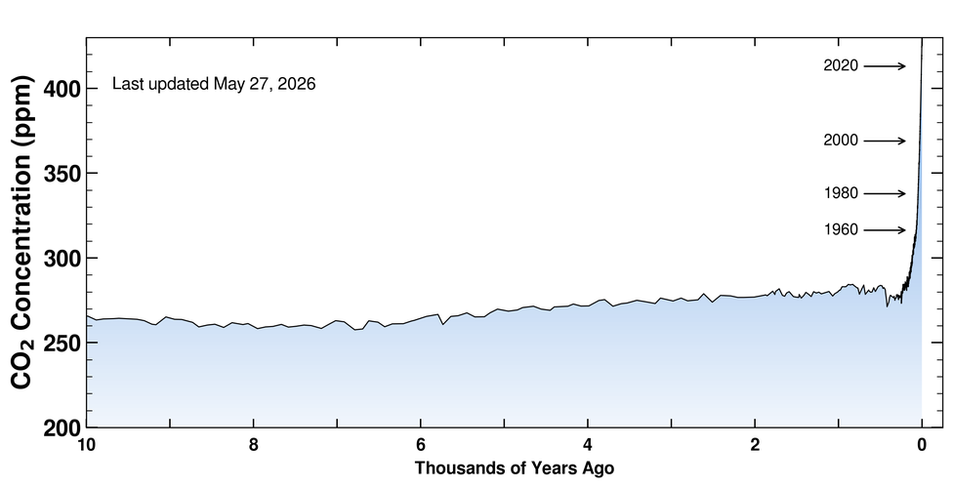
Activity 2 Source 1 (B)
You decide to do some more research. The first thing you find is this graph that shows the Carbon Dioxide levels from 1960 to 2026.
You can still see the increases and decreases of Carbon Dioxide every year, but what is happening to the overall amount over the years?
What do you think causes the changes each year?
Then, you find this graph:
This one shows the change over the last 10,000 years. It tells a very different story!
How did the person on the first graph try to trick you?
Notes:
All data taken from https://keelingcurve.ucsd.edu/

Slide 8

Activity 2 Source 2 (A)
You’re shopping and find a top with this label on it:
Eco Choice!
Contains recycled materials
Carbon-neutral
Contains 5% recycled materials
Made in the same factory as everything else using fossil fuels but we also planted some trees.
The shop even has a special bin to bring in your old clothing for recycling. Sounds great right!
But wait! What’s that on the bottom of the label?
Do you have any predictions on what tricks might have been played here?

Slide 9


Activity 2 Source 2 (B)
You get out your magnifying glass and read this:
Contains 5% recycled materials
Made in the same factory as everything else using fossil fuels but we also planted some trees.
Doing a bit more research, you learn that this shop send a lot of their clothing from the recycling bin to rubbish dumps in other countries because it’s too expensive to recycle.
You also learn that they didn’t even plant the trees, they paid someone else to do it for them. You can’t find any information on where or when the trees were planted.
Why do you think this shop has exaggerated how eco-friendly their clothing is?
Notes:
This is an amalgamation of stories from various green-washing scandals. More examples at https://thesustainableagency.com/blog/greenwashing-examples/
https://sustainthestyle.com/fashion-greenwashing-exposed-2026/#How_to_Spot_Fashion_Greenwashing_A_Practical_Guide

Slide 10
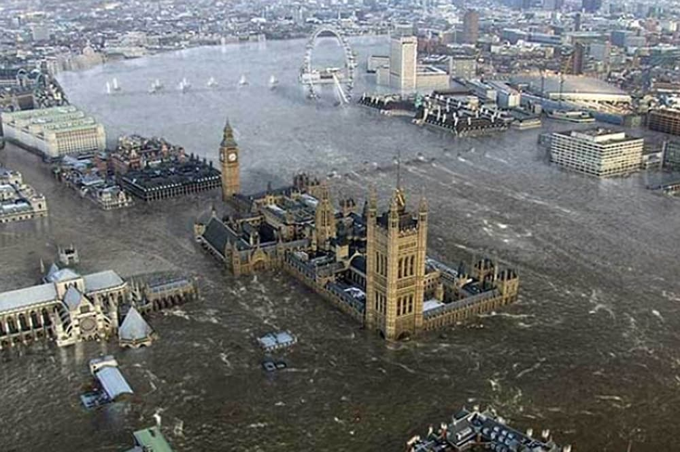
Activity 2 Source 3 (A)
You see this picture on social media
The caption says:
LONDON COULD LOOK LIKE THIS, AND SOONER THAN YOU THINK!
You read a bit more and it says that based on rising sea level predictions London could look like this by the year 2100.
It’s posted by a popular newspaper you have heard of before, so maybe it’s true?
What do you think?
Notes:
Images taken from The Telegraph, credited to Lionsgate Films https://www.telegraph.co.uk/comment/4975053/We-should-be-alarmed-about-rising-sea-levels.html

Slide 11
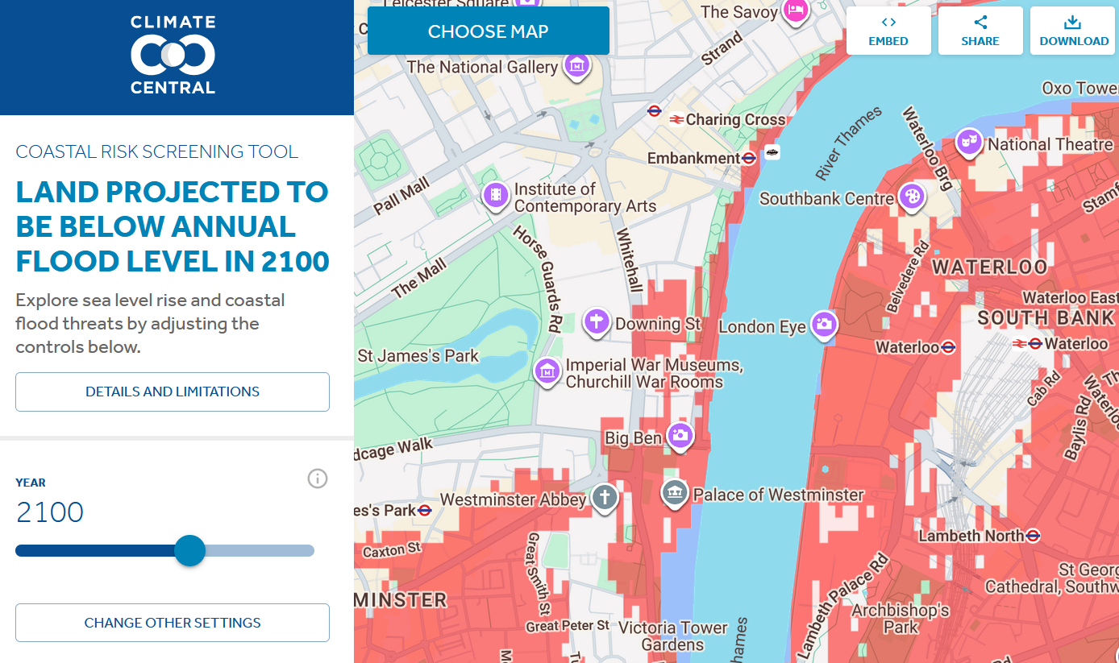

Activity 2 Source 3 (B)
This article does actually say where they got their information from. It’s a website called Climate Central that shows you on maps what places might look like when the sea level rises. This is the map they used.
But wait!
There’s a few sneaky things to pay attention to here.
Look at the areas the arrows point to and compare them to the picture. The map says they won’t be flooded, but in the picture they’re completely underwater.
Now look at the circled writing. It says below ANNUAL flood level. This means the areas in red won’t be underwater all the time, only if there is flooding.
Still bad, but not quite as dramatic!
A bit more research and you discover that the picture is actually from ‘Flood,’ a film that came out in 2007 and has a 4.8/10 rating on IMDB!
Notes:
https://coastal.climatecentral.org/map/16/-0.1206/51.5025/?theme=sea_level_rise&map_type=year&basemap=roadmap&contiguous=true&elevation_model=best_available&forecast_year=2100&pathway=ssp3rcp70&percentile=p50&refresh=true&return_level=return_level_1&rl_model=coast_rp&slr_model=ipcc_2021_med

Slide 12
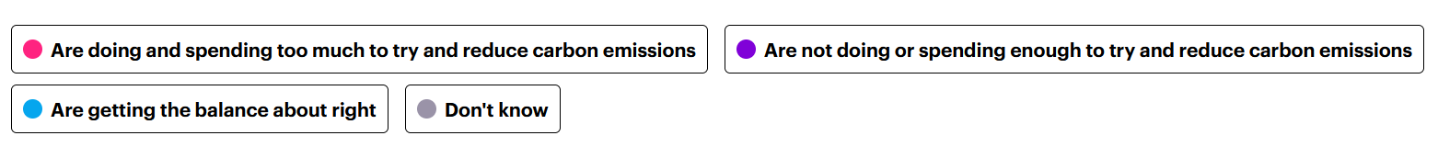
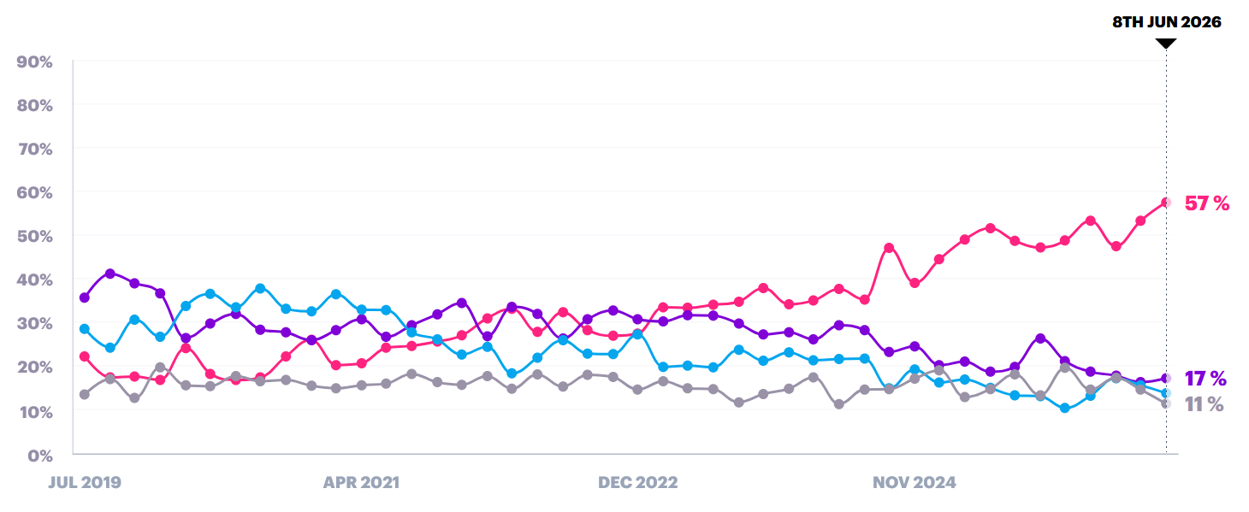
Activity 2 Source 4 (A)
Someone shows you this graph:
They say:
“More than half of people think the government is doing too much about reducing carbon emissions. It’s just not actually that big a deal.”
Is there anything you think they might not be telling you?
Notes:
https://yougov.com/en-gb/trackers/how-is-the-uk-government-handling-climate-change

Slide 13
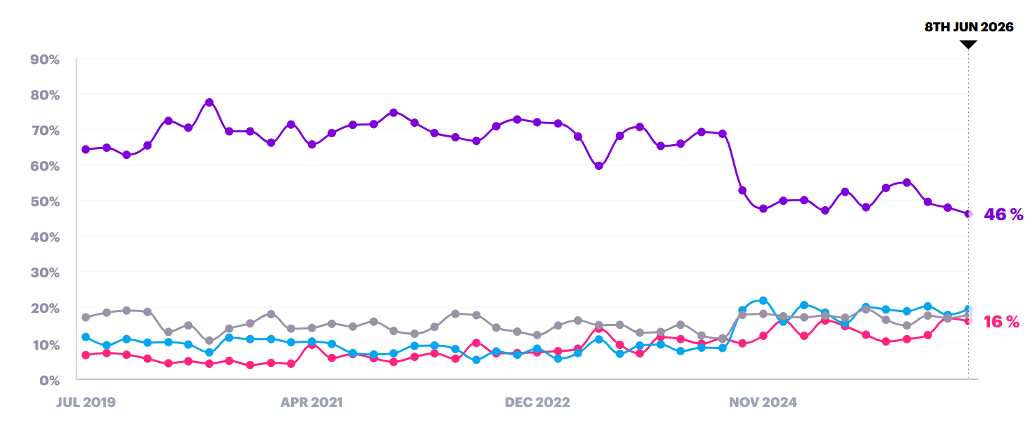
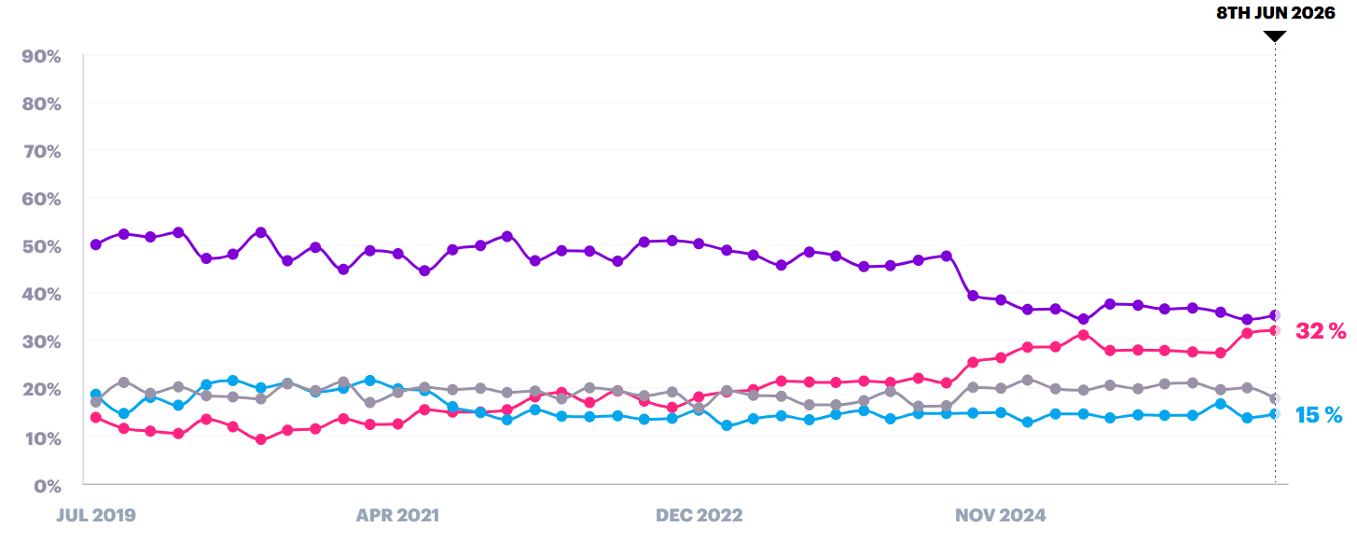
Activity 2 Source 4 (B)
You look at the website where they got the information and realise that they only showed you part of the data! The people they asked have political opinions that means they might already be unsure if climate change is that big a deal.
Here’s what the graph looks like if you only asked people with a different political opinion:
And here’s what it looks like with ALL the information:
What trick did they use here? What do you think they were trying to make you feel?
Notes:
https://yougov.com/en-gb/trackers/how-is-the-uk-government-handling-climate-change

Slide 14
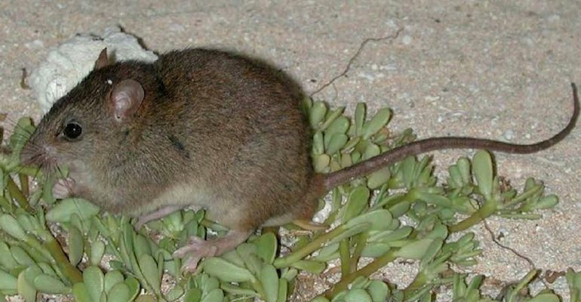
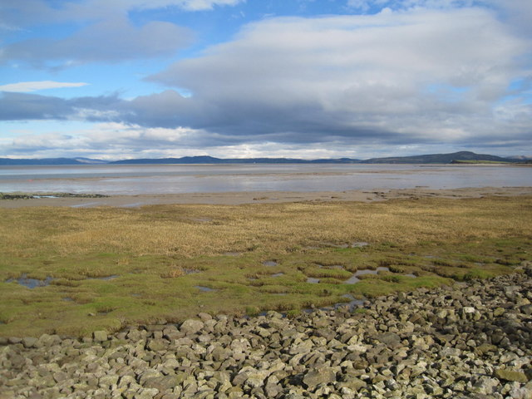
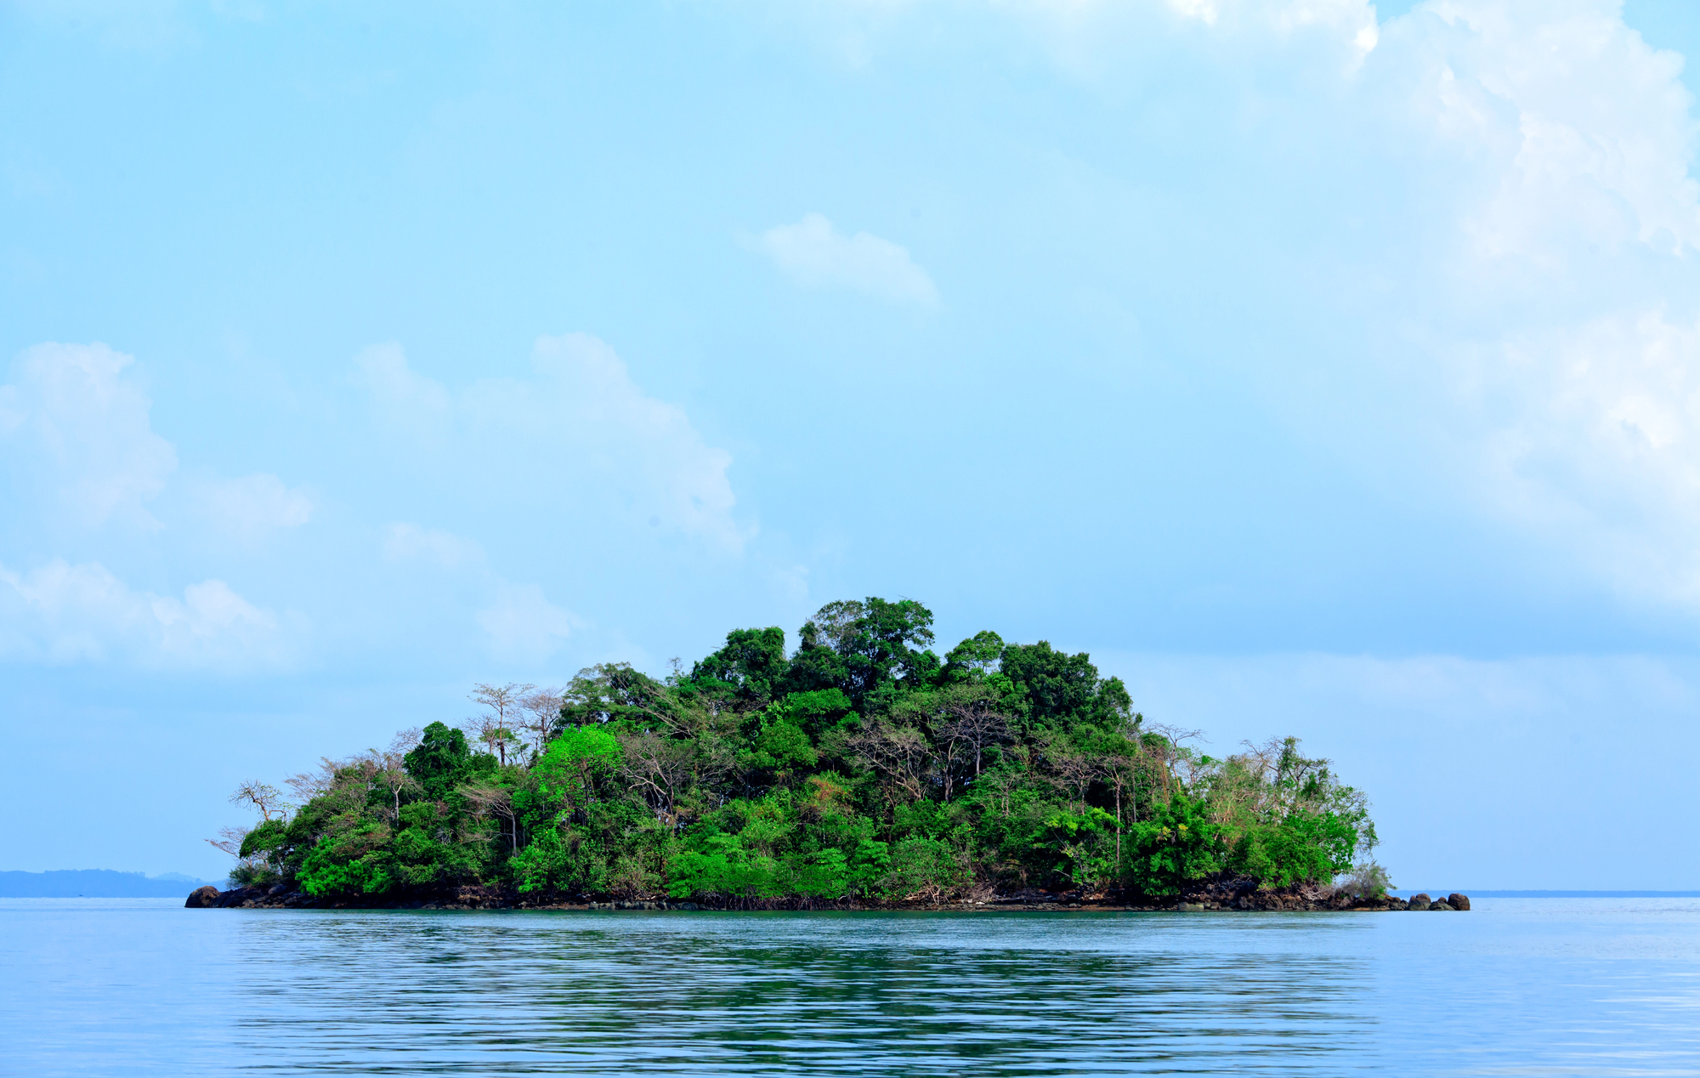
Activity 3 – Cards for sort
Wind turbines are good, but shouldn’t be built here because they will destroy the view completely. | There are approximately 11,000 wind turbines currently active around the UK. | It’s OK that they fly everywhere in a private jet because they also plant lots of trees to help the environment.
The Bramble Cay Melomys was declared extinct in 2019 when rising sea levels flooded the only small island it lived on. | The salt marsh growing in Morecambe Bay is ugly and scruffy, the council should get rid of it. | It doesn’t really matter if an animal I never heard of from a place I never heard of goes extinct. It doesn’t affect me.
I’m glad it doesn’t snow as much anymore. It messes the roads up and gets in the way. | The number of days over 30°C occurs more the 4 times more in London than it did in the UK climate 40 years ago. | Solar energy isn’t helpful, It rains too much here.
UK families can save around £500 a year on their electricity bill with solar panels on the roof. | Trains and buses are a waste of money, it’s easier to drive. | Travelling by train instead of car would produce 75% less carbon emissions.
Notes:
Bramble Cay Melomys image: By State of Queensland, CC BY 3.0 au, https://commons.wikimedia.org/w/index.php?curid=49457717
30C days – State of the UK Climate report 2025
Solar panel savings: https://www.gov.uk/government/news/homeowners-could-save-hundreds-on-energy-bills-from-solar-drive
Morecombe Bay picture – Field Studies Council

Slide 15
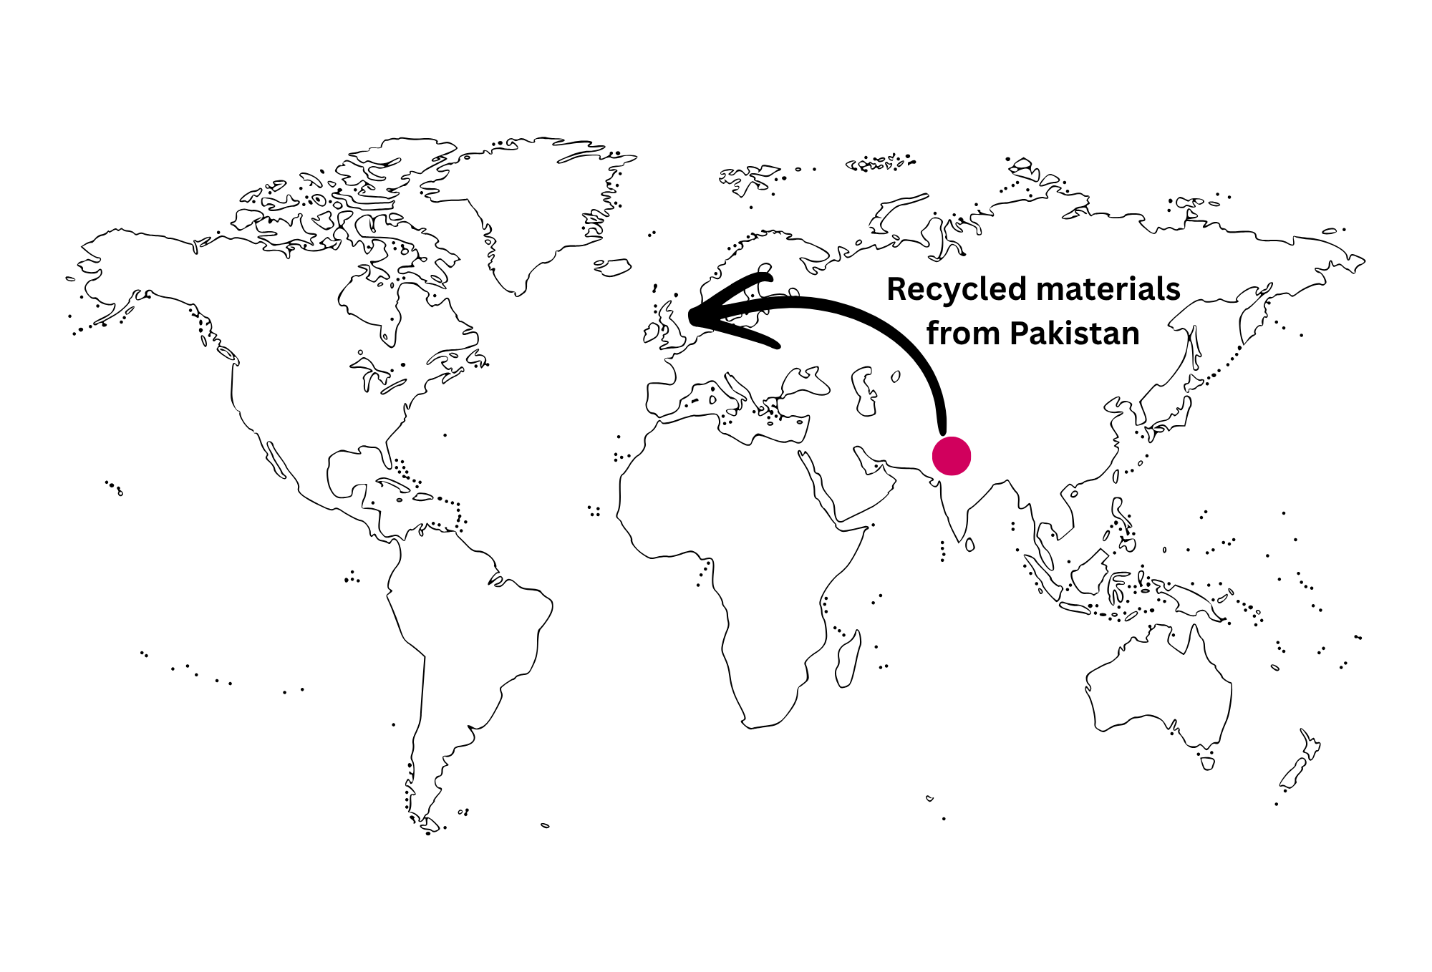
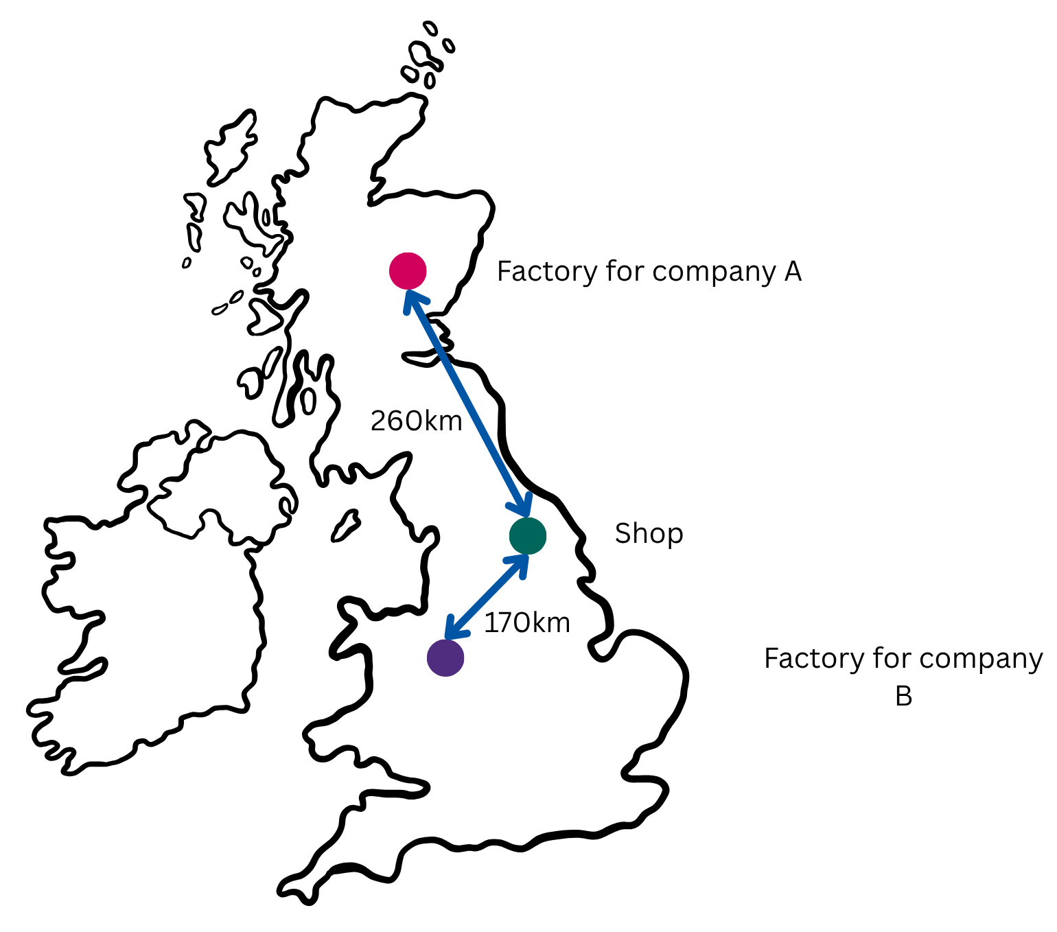


Compare the Two Backpacks
Activity 5
Company A: BAG to School
Material production: Locally in Scotland
Transport of materials: By lorry
Manufacturing: Factory near Scotland
Transport to shop: By lorry
Packaging: Cardboard
Number of bags sold every year: 50,000
Company B: EcoBags
Material production: Recycled materials from Pakistan
Transport of materials: By plane
Manufacturing: Factory in Birmingham
Transport to shop: By lorry
Packaging: Recycled plastic
Number of bags sold every year: 50,000

Slide 16
Compare the Two Backpacks
Activity 5
Transport of material from Pakistan to factory B via plane 90kg CO₂ per year | Emissions to make the cardboard packaging for UK travel 0.012kg CO₂ per year | Production of new materials in Scotland 10kg CO₂ per year
Transport of material from Scotland to factory A via lorry 0.15kg CO₂ per year | Transport of bags from factory A to shop by lorry 0.2kg CO₂ per year | Emissions of recycled plastic packaging for international travel 0.003kg CO₂ per year
Manufacturing of the bag in Factory A 2kg CO₂ per year | Transport of bags from factory B to shop by lorry 0.13kg CO₂ per year | Production of recycled material in Pakistan 1.5kg CO₂ per year
Manufacturing of the bag in factory B 2kg CO₂ per year

