Slide 1

Can my School Adapt to and Resist a Heatwave?

Slide 2
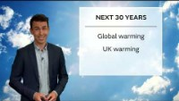
Climate change and extreme heat in the UK
Watch the weather forecast opposite, what could the weather be like in the UK in 2050? What could it be like where YOU live?
https://youtu.be/I-o4IXrS8do

Slide 3
Extreme Heat and Climate Change

Slide 4
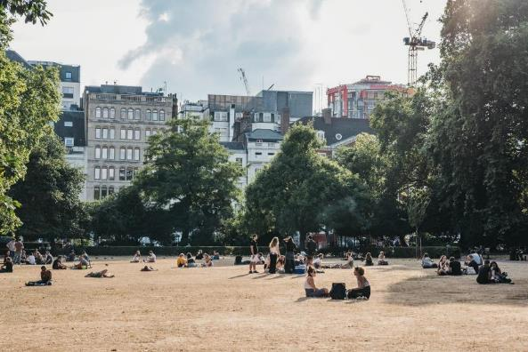
What causes Heatwaves?
Heatwaves form when the weather is calm, clear and settled.
They form under High pressure conditions where air is sinking to the Earth’s surface.

Slide 5
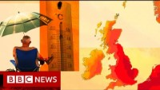
Extreme heat in the UK
What is the definition for a UK heatwave?
For a heatwave to occur in the UK a place must record at least three consecutive days with daily maximum temperatures meeting or exceeding the heatwave temperature - this is 28°C in London and 25°C for much of the rest of the country
Watch the video – what impact is climate change having on heat waves?

Slide 6

Summer 2022 was:
The UK’s warmest year on record.
When the UK’s highest ever temperature was recorded: 40.3℃ in Coningsby, Lincolnshire.
England’s joint warmest Summer on record (alongside 2018).

Slide 7
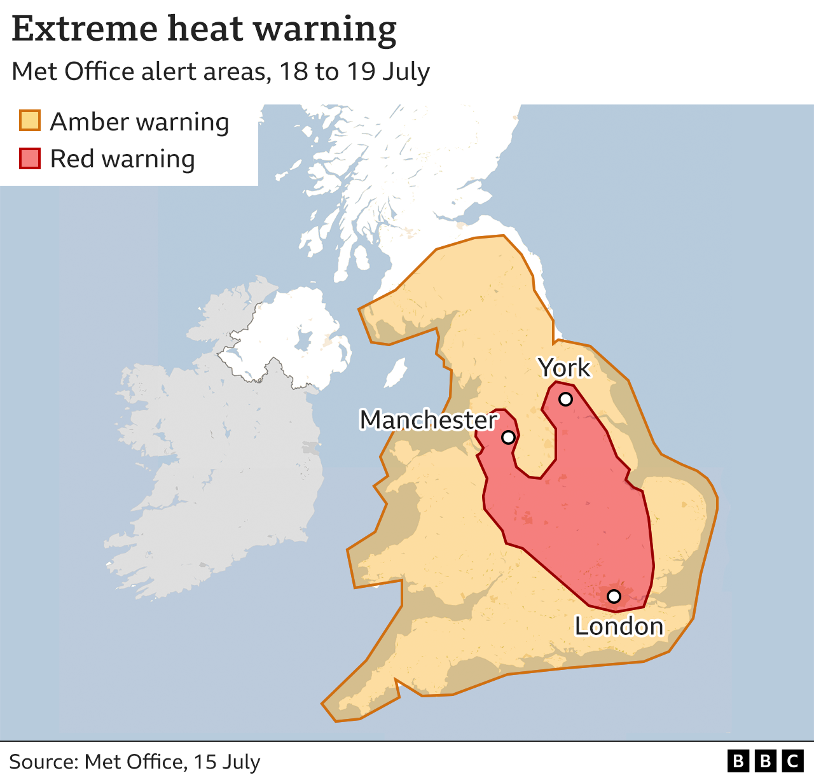
Extreme heat in the UK
In July 2022 there was a heatwave which affected large parts of the UK, especially on the 18th and 19th of the month.
Can you remember what it was like?
Did it have any impact on what you did during that time?
Look at the map opposite, describe (in pairs) the distribution of the areas under a red warning from the Met Office.
A red warning means that “Dangerous (hot) weather is expected and, if you haven't already done so, you should take action now to keep yourself and others safe from the impact of the severe (hot) weather.”
Make a list of the dangers hot weather could pose to people and the environment.
Suggest reasons why different areas of the UK experience varying maximum temperatures.
Possible Impacts on People | Possible Impacts upon the Environment

Slide 8
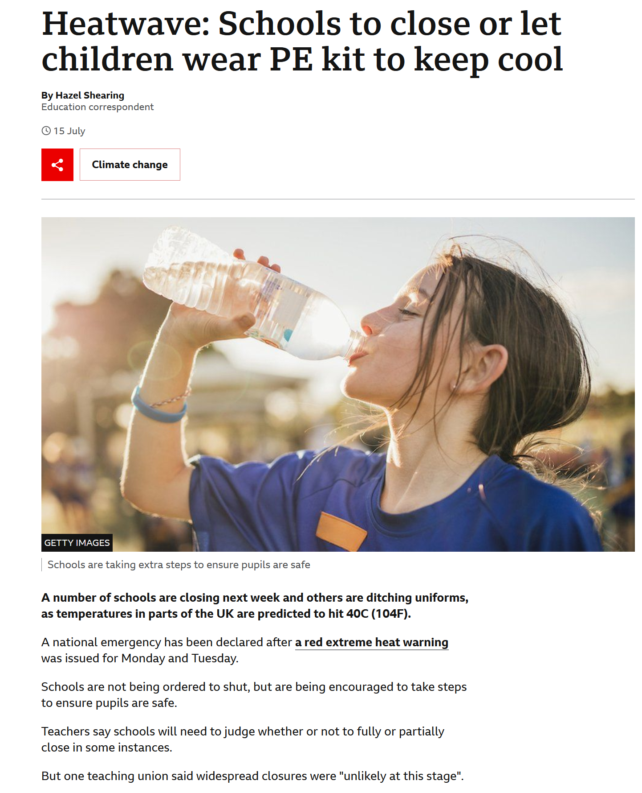
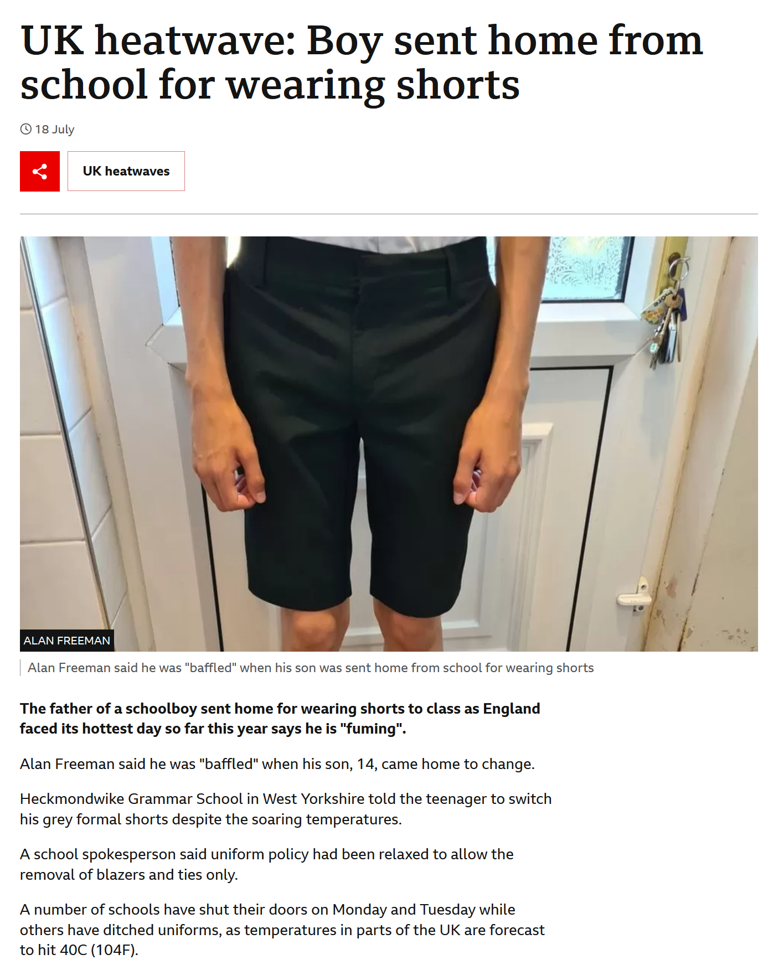
Read the news article from the BBC.
At what temperature should schools shut?
Should students be allowed to wear their PE kit to stay cool?
Read the news article from the BBC.
What are your opinions on the article? Who was in the wrong – the school or the boy? Why?

Slide 9


Some studies show:
High temperatures affect student behaviour and may cause students to be;
Listless (lack energy or enthusiasm),
Fatigued (tried),
Restless.
This affects learning.
How well do children learn when it is hot? Discuss in pairs

Slide 10
Climate Change and Extreme Heat in the UK

Slide 11
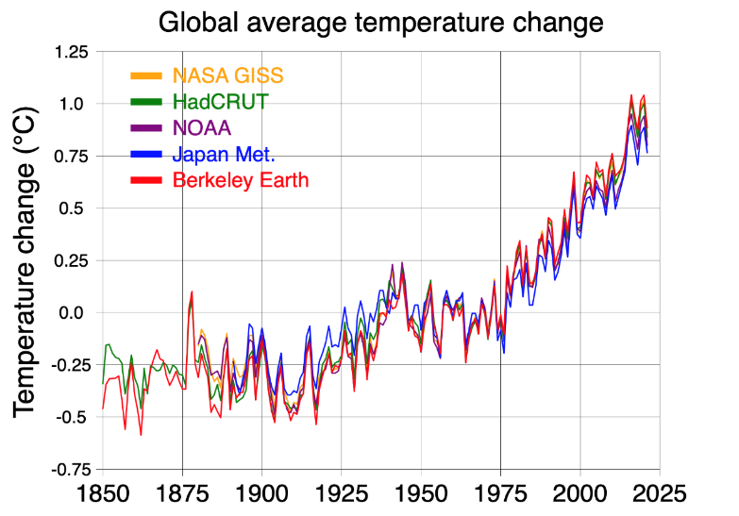
What is happening to the Earth’s climate?
Image: Wikimedia Commons

Slide 12
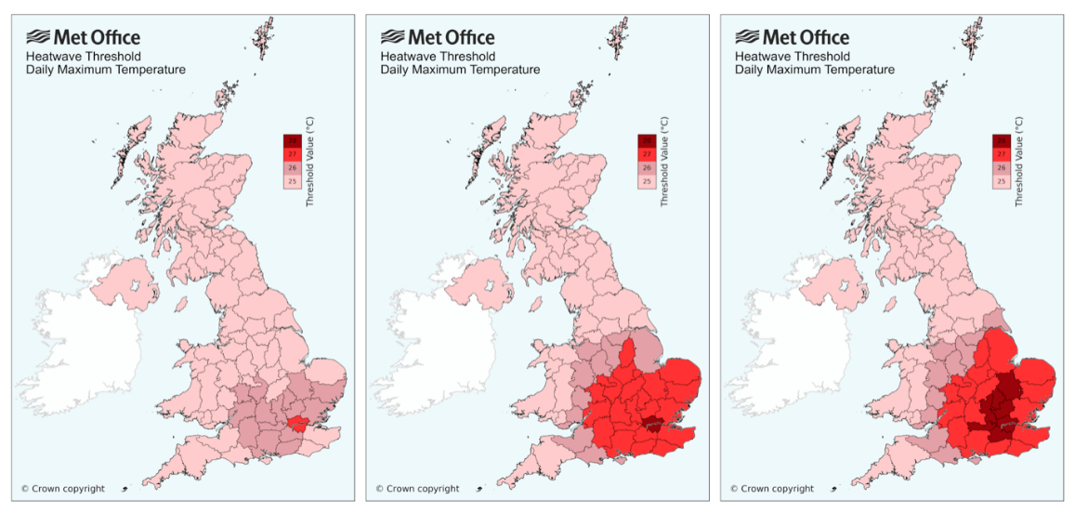
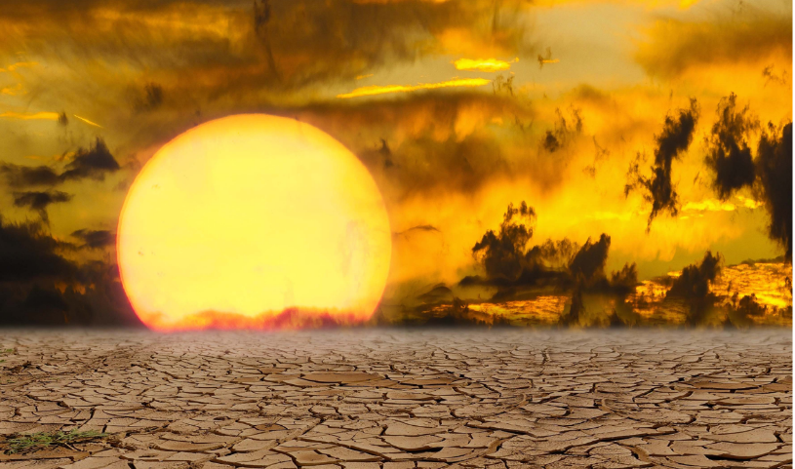
HOW IS CLIMATE CHANGE AFFECTING HEATWAVES?
Before 1991
1991
2022

Slide 13
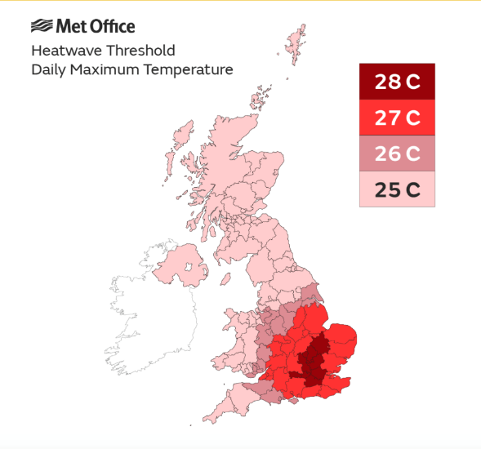
Do you think that the heatwave threshold should be the same all over the UK?

Slide 14
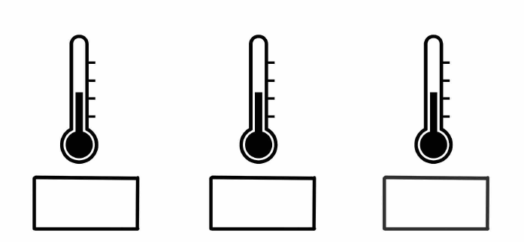
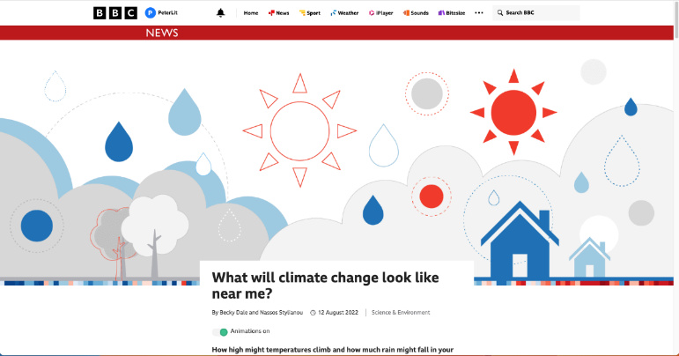
ACTIVITY: Find out how temperatures might change in your area in the years to come.
1991-2019
2°C
4°C
Use the climate calculator on this webpage to complete the diagram on the maximum summer temperature where you live.

Slide 15
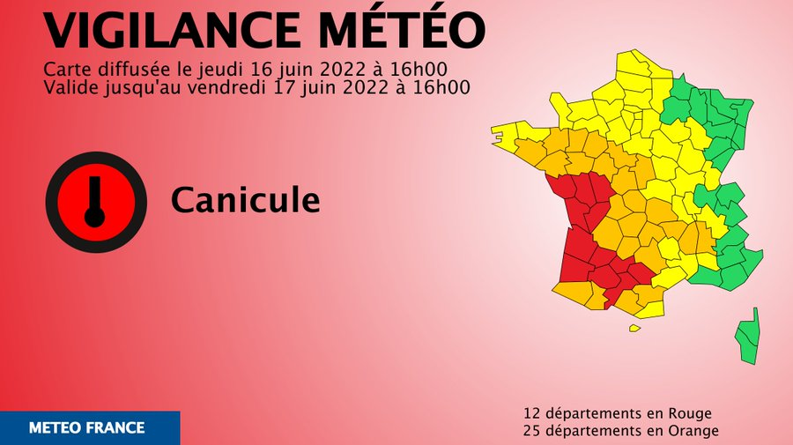
Other countries have plans in place to deal with extreme heat events
For example, France’s annual ‘plan canicule’ is a system set up to manage heatwaves.
France's ministry of education states that school pupils in primary or collège level do not need to go to school when a red alert has been declared.
The plan was a response to a heat wave in 2003 were almost 19,000 people died as a result of excess heat
In Germany you can be sent home from school if your classroom is too hot!!!
In Bremen, students will be sent home if the indoor temperature exceeds 25 degrees.
What do YOU think of this idea?

Slide 16

If you were guiding headteachers, what would you advise them to do with their buildings during a heat wave? Make a list
Advice from the FRENCH government to their headteachers
Identify the most exposed buildings/rooms
Change the organization and use of spaces based on exposure to heat (accommodate students in less exposed or protected facades, green and covered spaces, etc. ).
Keep blinds or shutters closed when the building front is sunny.
Limit the opening of windows: the renewal of air can be obtained by opening them for a short time (between five and ten minutes).
Allow rooms to be cooled by opening windows at night when possible
If a room is air-conditioned, use it as a refuge (safe) room.
How many did you get?

Slide 17
Can my school adapt to and resist a heatwave?

Slide 18

Can my school adapt to and resist a heatwave?
In 2022, temperatures of 40°C were recorded for the first time. By 2100, the UK could see 40°C every three to four years unless we as a global community take very rapid action to limit the amount of greenhouse gases in the atmosphere.
For many schools, the risks of extreme heat – heat waves, are higher than the risks of climate-related flooding.
Are our schools ready? Discuss in pairs!

Slide 19
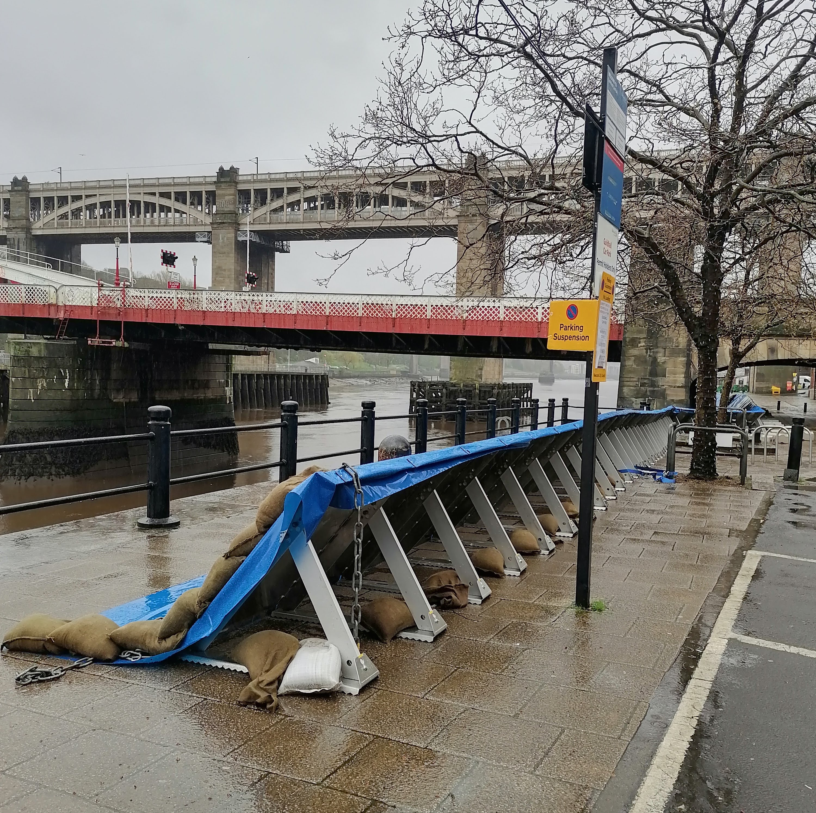
EXTREME HEAT - Adaptation and Resilience
Adaptation refers to solutions and actions used to respond to current and future climate change impacts. Examples include building flood defences, setting up early warning systems for cyclones, & switching to drought-resistant crops.(source)
TASK - How can we adapt schools to extreme heat hazards caused by climate change?
Pop up flood defences along the River Tyne, April 2024

Slide 20
Climate Resilience
Stresses are slower to start and change, e.g. changes in precipitation, rising temperatures and seasonal shifts.
Climate resilience involves having the capacity to:
Absorb stresses
Anticipate climate risks
Anticipate climate hazards
Absorb shocks
Transform long term development
Shocks – such as floods, storms or wildfires – are immediate, destructive and relatively short lived
Climate resilience involves people, businesses and governments being able to cope with climate change.
Look carefully at the 5 items opposite about climate resilience.
Which ones are relevant to schools in the UK and their ability to be resilient to extreme heat? Discuss in pairs.
Climatic hazards are disasters that affect human settlements or the environment
Climate risk is the potential for problems for societies & ecosystems from the impacts of climate change
Notes:
Infographic based upon https://unfccc.int/sites/default/files/resource/ExecSumm_Resilience_0.pdf

Slide 21
Can my school adapt to and resist a heatwave? The fieldwork element for the next lessons

Slide 22
Can my school Adapt to and Resist a Heatwave?
Fieldwork options
1. OUTSIDE – what impacts do micro-environments have on temperature?
2. OUTSIDE – what impact do trees have on temperature?
3. INSIDE – Which rooms are most vulnerable to extreme heat?

Slide 23
Homework - reminiscences and a questionnaire

Slide 24
Homework
If everyone in the class gets 2 responses we will have x sets of data, is this enough to form a reliable conclusion?
Between us, how can we try to get a representative sample across the school?
How can we ensure that we get a representative sample?
Ask two people (students or teachers) to complete the school classrooms heat questionnaires. Either the paper copy or using the Microsoft Forms link.
Teachers – here is the link to duplicate the Microsoft Form. This will collate all of your results for you and produce graphs that you can analyse as a class.
Interview one person from your family or community using the Reminiscences sheet
Notes:
https://forms.office.com/Pages/ShareFormPage.aspx?id=DQSIkWdsW0yxEjajBLZtrQAAAAAAAAAAAAEYJ0yFpGxUNzBJQ1pBS0wxUkZKRFZRSVlDWTBYVTM0SS4u&sharetoken=x73AdDroNhCS8lf3UKEN

Slide 25
