Slide 1
Can my school adapt to and resist a heatwave? Heatwave Fieldwork: Inside the School

Slide 2
EXTREME HEAT - Adaptation
Adaptation refers to solutions and actions used to respond to current and future climate change impacts. Examples include building flood defences, setting up early warning systems for cyclones, & switching to drought-resistant crops.(source)
TASK - How can we adapt schools to extreme heat hazards caused by climate change?
Pop up flood defences along the River Tyne, April 2024

Slide 3
Heatwave Fieldwork: Inside the School
Discuss:
Which classrooms and other areas of the school are particularly warm in summer or cold in winter? Are they the same places?
How could you measure this using a thermometer?
How could you measure this if you didn’t have a thermometer?
Click on the Sun for a 1 - minute timer

Slide 4
You are going to conduct some fieldwork inside the school. The goal is to work out which rooms in the school are most vulnerable to extreme heat in the summer. Overall, this should help you to answer the question “Can my school adapt to and resist a heatwave?”

Slide 5
Possible Approach 1 – Room sampling and audit
Room number | Temperature | Aspect of windows | Number of windows | Number of openable windows | Number of exposed radiators | Number of sources of heat in the room (e.g. computers, smart boards) | Air conditioned?
Add ten rooms from your school into column 1 on the table. These rooms should be representative of the school. Consider different window aspects, numbers of windows etc. You might include the coldest and warmest rooms from slide 4 in this.
Then collect your data, there is guidance on the next slide.

Slide 6
Possible approach 1 - Guidance
It would be a good idea to check with the teachers using the rooms if it is OK to come in to conduct a survey. Be polite and let the member of staff know that the survey takes no more than 5 minutes.
To collect the temperature data, allow a couple of minutes for your thermometer to adjust to the room before taking a reading.
Use a compass to work out which way the windows are facing (the aspect). This is important as it can show which direction the Sun will be.
Count the number of windows in the room. Then count the number of windows that can be opened.
If there are radiators in the room, count those up to.
Tally the number of electrical sources in the room such as smart boards, computers and printers.
Finally, look for any evidence of air conditioning, vents in the ceiling, an air conditioning unit, air conditioning controls on the wall. The teacher in the room may know.
Room number | Temperature | Aspect of windows | Number of windows | Number of openable windows | Number of exposed radiators | Number of sources of heat in the room (e.g. computers, smart boards) | Air conditioned?

Slide 7
Possible Approach 2 – how temperature changes in rooms during a day.
Simply record the temperature in 3 to 4 rooms every hour across the course of a day – What happens?
Room number | 08:00 | 09:00 | 10:00 | 11:00 | 12:00 | 13:00 | 14:00 | 15:00 | 16:00
If you cannot access the rooms over the course of the day ask a teacher in the room to do it for you!
Record the temperatures here or directly onto the Excel file

Slide 8
Possible Approach 3 – Student voice
What are the warmest 5 rooms in the school?
Ask students from a range of years which they think the warmest 5 rooms in the school are.

Slide 9
Possible Approach 4
Score each classroom for comfort in the summer
Ask students from a range of years to give a score out of 10 to each classroom for comfort on a hot day (10 = really comfortable, 1= really uncomfortable)

Slide 10
How will you collect your data?

Slide 11
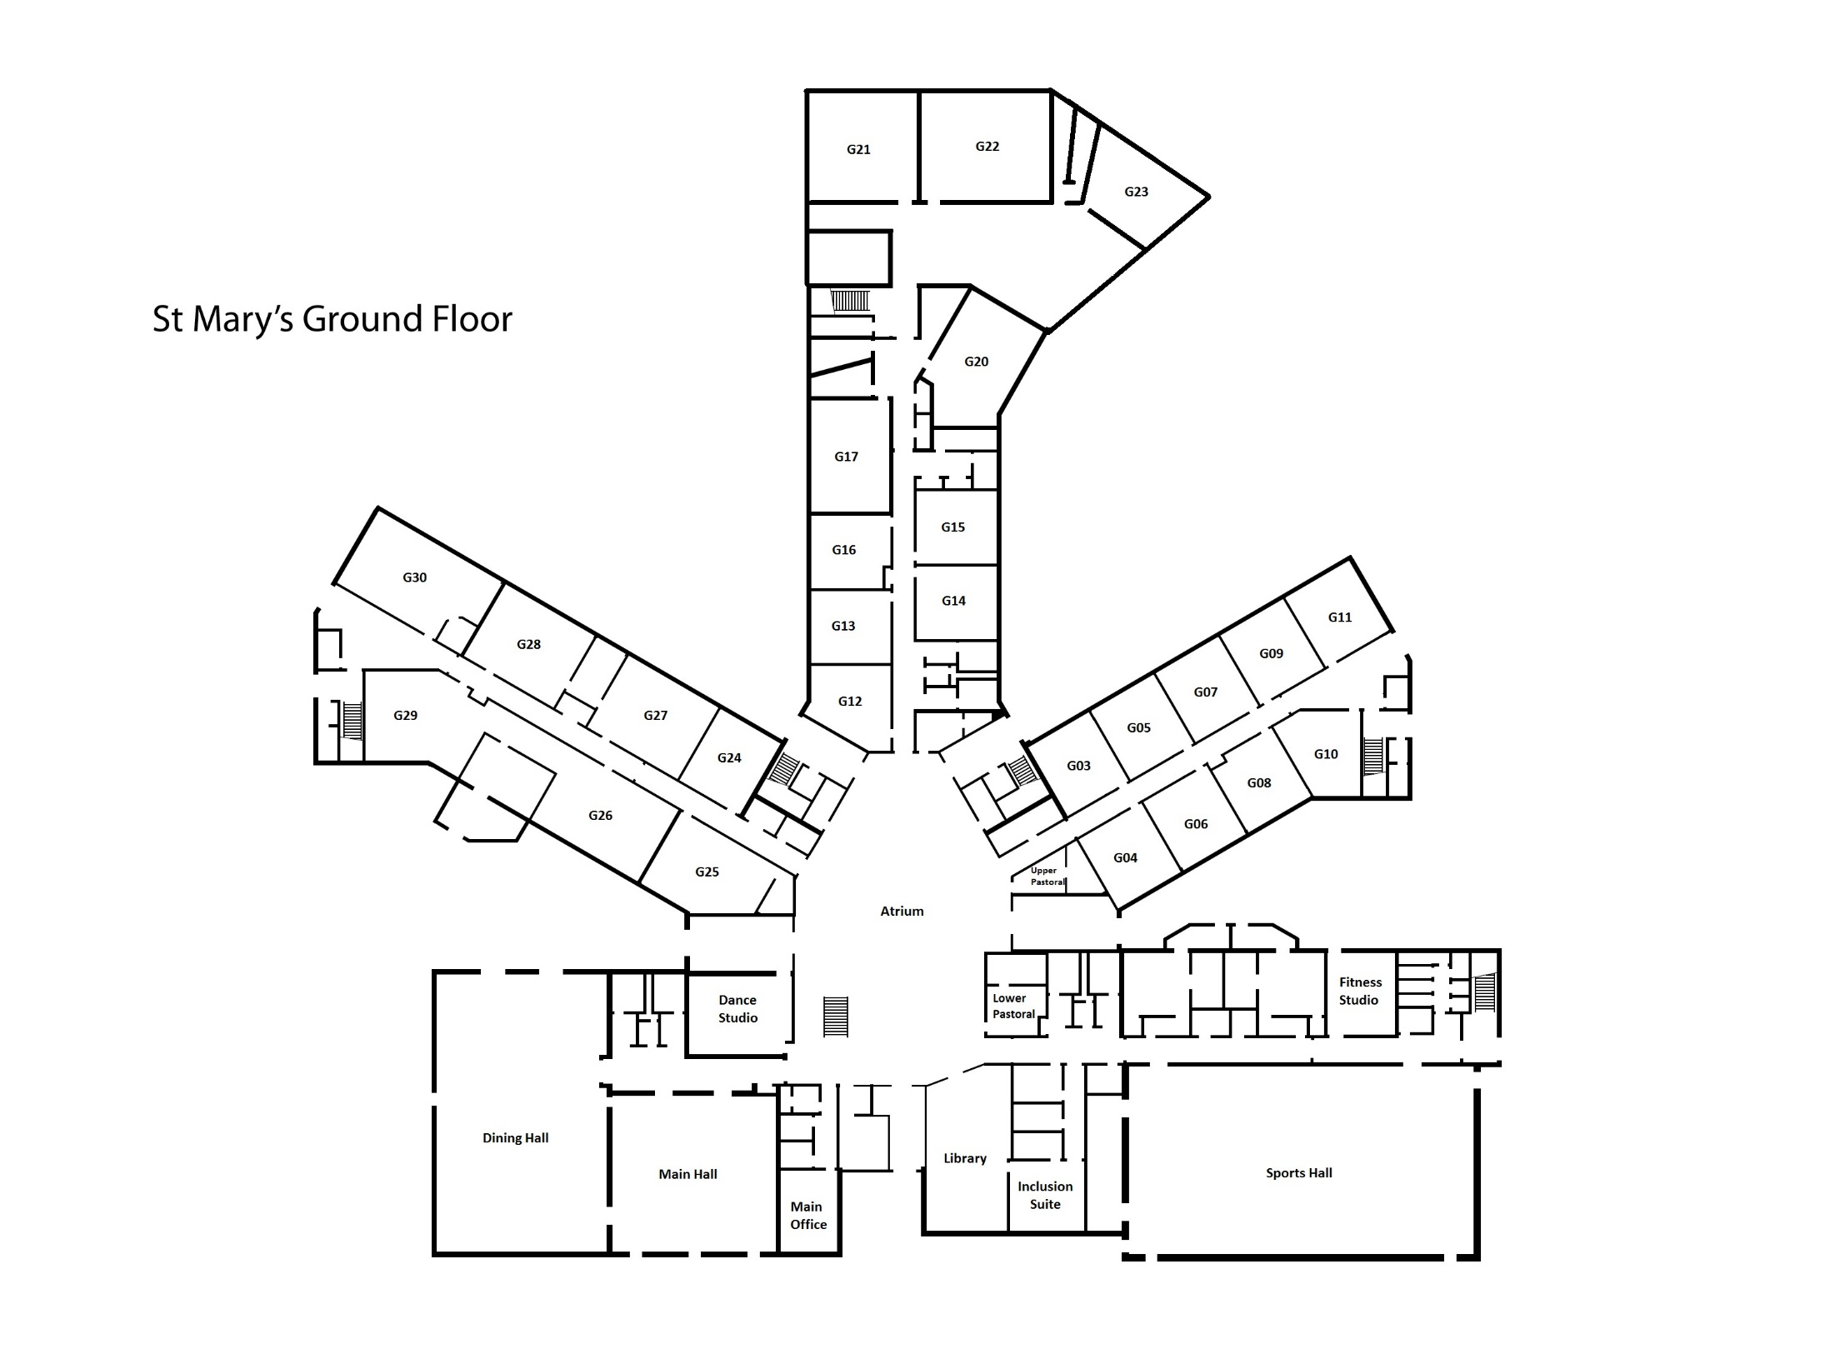
Can my school adapt to and resist a heat wave? Produce a sampling plan!
In pairs you need to produce a sampling plan.
Consider carefully WHERE you will collect your data and HOW. Which sampling strategy will you use? Why?
What equipment will you need?
How many measurements will you make in each location?
Draw your locations onto the school map.
The plan should ensure that your data collected is reliable and representative.
PRESENT your plan to another pair
N
Place a plan of your school above!

Slide 12
Writing Frame
Label your data collection points onto the map!
N
We will collect out data in the following places…
We will use a …..sampling strategy…
We selected this type of sampling because…... Which sampling strategy will you use? Why?
The equipment we will use includes…
We will collect…measurements in each location. This is because….
Our data collection plan is reliable and representative because….

Slide 13
Writing up your data

Slide 14
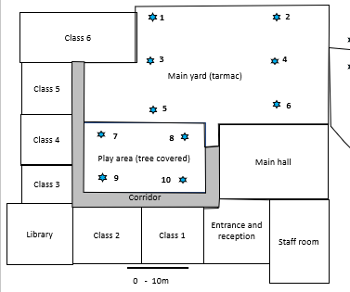
How will you display your data?
In pairs discuss how you can display your data.
The “Internal Fieldwork” Excel file will autogenerate a scatter graph in the “Room Data” Tab and a line graph in the “Change over the school day” tab.
Alternatively, students could graph the data on paper.
They could also produce a heat map, colour code the school according to a five-point scale as displayed opposite.
<19°C | 19-19.9°C | 20-20.9°C | 21-21.9°C | >22°C

Slide 15
Can my school adapt to and resist a heatwave? Heatwave Fieldwork: Inside the school building
Write about your results!
Remember to PEEL AS you go!
Points with numbers (Evidence)
Explanation
Links to other data sets/theory
Unusual results (Anomalies)
Specialist terms
Place a graph from the spreadsheets here. Or get the students to draw their graph, on graph paper.

Slide 16
Can my school adapt to and resist a heatwave? Example write up.
Points with numbers (Evidence)
Explanation
Links to other data sets/theory
Unusual results (Anomalies)
Specialist terms

Slide 17
Review - Can your school adapt to and resist a heatwave?
Explain what you’ve discovered
?

