Slide 1



Can my school adapt to and resist a heatwave?
Discussion task
What conditions will generate the most useful/ interesting data about if our school can adapt to and resist a heatwave??
Click on the Sun for a 1 minute timer
What is the weather like today when we when you will carry out your sampling? Is it ideal?

Slide 2

Can my school adapt to and resist a heatwave?
Heatwave Fieldwork: what impact do trees have on temperatures in the school grounds?

Slide 3
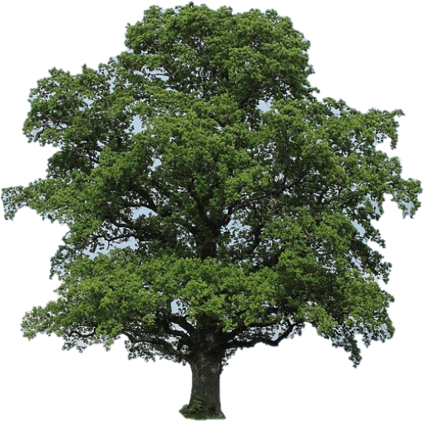
How do Trees Affect the Microclimate?
Shade – the trees absorb or reflect the Sun’s light and stop it reaching and warming you if you are standing in the tree’s shade.
Shade – the trees absorb or reflect the Sun’s light and stop it reaching and warming the ground in the tree’s shade, which would then warm you.
Evapotranspiration – water evaporating from the tree’s leaves cools the tree and the air around it, just like sweating cools you.

Slide 4

How to collect data - SAMPLING

Slide 5




What exactly IS a “sample”?
A sample is a subset of the population.
The Population
Is this sample RELIABLE and REPRESENTATIVE?
Reliable – is the data we collect trustworthy?
Representative – does the data reflect the characteristics of the entire population?
Notes:
If students say ‘yes’ to ‘is this sample reliable and representative then prompt them to consider gender and colour

Slide 6
Populations and samples
In reality a population does not have to be people! A population could be;
The plants in a sand dune ecosystem
Air quality levels around a city
Traffic volumes on a road
Life in a pond
To select a sample to represent a population fairly and reliably researchers use SAMPLING.

Slide 7
Simple Random sampling
Every member of the population has an equal chance of being selected. To conduct this type of sampling, you can use tools like random number generators or other techniques that are based entirely on chance.

Slide 8
Systematic Sampling
Every member of the population is listed with a number, but instead of randomly generating numbers, individuals are chosen at regular intervals. These intervals could be by time or distance.

Slide 9
Stratified Sampling
This divides the population into subgroups based on the relevant characteristic (e.g., gender, age range, dune stage, altitude).
Based on the overall proportions of the population, you calculate how many of the population should be sampled from each subgroup.

Slide 10
Equipment

Slide 11
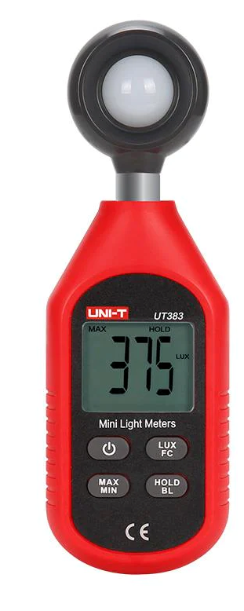

Equipment – light meter
Light Condition | Typical lux
British summer sunshine | 50,000
Ambient Daylight | 10,000 to 25,000
Overcast Daylight | 1,000 to 5,000
Well-lit office | 500
Sunset & Sunrise | 400
Family Living Room | 120
Lifts | 100
Street Lighting | 15
Moonlight (Full moon) | 1
Night (No moon) | <0.01
This is a light meter.
It measures light intensity in units of lux or FC.
The higher the reading the lighter it is.
You can get FREE light meter apps for your phone – the Lux Light meter Pro works well

Slide 12
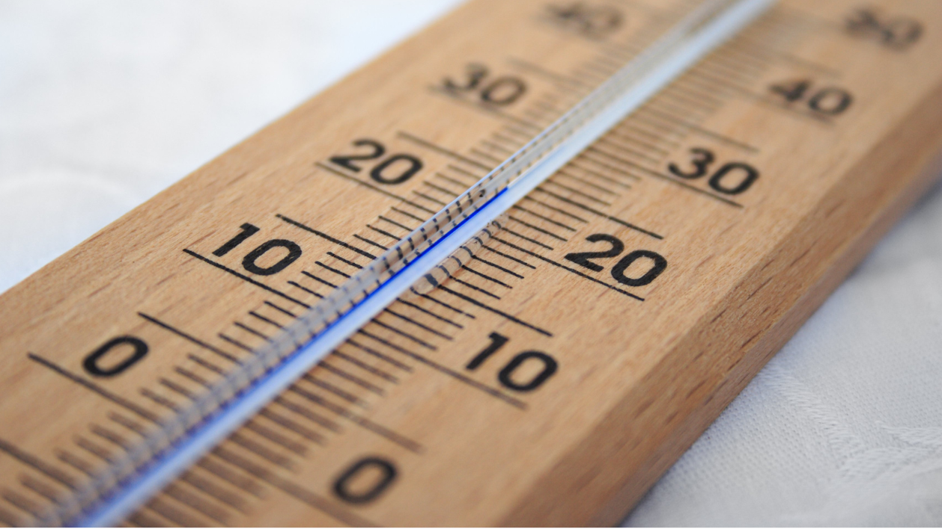
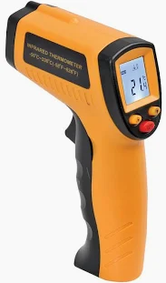
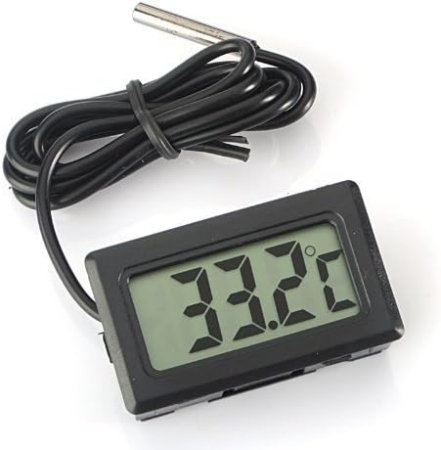
Equipment - thermometer
Thermometers will measure the temperature for you.
You could use an alcohol, digital or infrared thermometer.
Time will be needed to allow the thermometer to adjust to the air temperature

Slide 13
Fieldwork Investigation - what impact do trees have on temperatures in the school grounds?

Slide 14
What impact do trees have on temperatures in the school grounds?
Sampling Method – Systematic sampling
Place a tape measure either side of the tree around its stump, 25m on either side.
Start at the stump and measure both the temperature and light levels. Don’t forget to allow the thermometer time to adjust before taking the reading.
Move five meters away and repeat the temperature and light measurements.
Repeat until you are 25m away from the tree.
Once done, repeat the process on the other side of the tree. You should end up with ten results.
These results can be recorded on the Excel file.
5m

Slide 15
What impact do trees have on temperatures in the school grounds?
 | Light | Temperature
1 |  |  | Furthest from Tree Stump
2
3
4
5 |  |  | Closest to tree stump
6 |  |  | Closest to tree stump
7
8
9
10 |  |  | Furthest from Tree Stump
Sampling Method – Systematic sampling
5m

Slide 16
What impact do trees have on temperatures in the school grounds? METHOD 2
Collect the temperature and light readings in concentric circles around the tree.
Start at the stump and take 4 readings around the base of the tree, perhaps at all major points of the compass.
Move out 3 to 5m (depending on the size of the tree) and take 4 more readings around the tree.
Repeat more times until you are clear of the tree canopy.
These results can be recorded on the Excel file.

Slide 17
Alternative fieldwork – what impact do trees have on temperatures in the school grounds? METHOD 2
Temperature measurements
 | 1 | 2 | 3 | 4 | Mean
Base of tree tump
5m away from base
10m away from base
15m away from the base
20m away from the base
Increments above can be adjusted dependent upon the size of the tree and its crown.
Light measurements
 | 1 | 2 | 3 | 4 | Mean
Base of tree tump
5m away from base
10m away from base
15m away from the base
20m away from the base

Slide 18
Writing up your data

Slide 19
Can my school adapt to and resist a heatwave?
Heatwave Fieldwork: what impact do trees have on temperatures in the school grounds?
Write about your results!
Remember to PEEL AS you go!
Points with numbers (Evidence)
Explanation
Links to other data sets/theory
Unusual results (Anomalies)
Specialist terms
Place a graph from the spreadsheets here. Or get the students to draw their graph on graph paper.

Slide 20
Can my school adapt to and resist a heatwave? what impact do trees have on temperatures in the school grounds?
Example write up.
Points with numbers (Evidence)
Explanation
Links to other data sets/theory
Unusual results (Anomalies)
Specialist terms

Slide 21

Review - Can your school adapt to and resist a heatwave?
Explain what you’ve discovered
?

