Slide 1
Can my school adapt to and resist a heatwave?
Discussion task
What weather conditions will generate the most useful/ interesting data about whether our school can adapt to and resist a heatwave??
Click on the Sun for a 1 minute timer
What is the weather like today when we when you will carry out your sampling? Is it ideal?

Slide 2
Can my school adapt to and resist a heatwave? Heatwave Fieldwork: Around the School Grounds

Slide 3
Measuring temperature and light around our school

Slide 4
How to collect data - SAMPLING

Slide 5
What exactly IS a “sample”?
A sample is a subset of the population.
The Population
Is this sample RELIABLE and REPRESENTATIVE?
Reliable – is the data we collect trustworthy?
Representative – does the data reflect the characteristics of the entire population?
Notes:
If students say ‘no’ to ‘is this sample reliable and representative then ask them to look at the numbers of each gender and colour

Slide 6
Populations and samples
In reality a population does not have to be people! A population could be;
The plants in a sand dune ecosystem
Air quality levels around a city
Traffic volumes on a road
Life in a pond
To select a sample to represent a population fairly and reliably researchers use SAMPLING.

Slide 7
Simple Random Sampling
Every member of the population has an equal chance of being selected. To conduct this type of sampling, you can use tools like random number generators or other techniques that are based entirely on chance.

Slide 8
Systematic Sampling
Every member of the population is listed with a number, but instead of randomly generating numbers, individuals are chosen at regular intervals. These intervals could be by time or distance.

Slide 9
Stratified Sampling
This divides the population into subgroups based on the relevant characteristic (e.g., gender, age range, dune stage, altitude).
Based on the overall proportions of the population, you calculate how many of the population should be sampled from each subgroup.

Slide 10
Equipment

Slide 11
Equipment – light meter
Light Condition | Typical lux
British summer sunshine | 50,000
Ambient Daylight | 10,000 to 25,000
Overcast Daylight | 1,000 to 5,000
Well-lit office | 500
Sunset & Sunrise | 400
Family Living Room | 120
Lifts | 100
Street Lighting | 15
Moonlight (Full moon) | 1
Night (No moon) | <0.01
This is a light meter.
It measures light intensity in units of lux or FC.
The higher the reading the more lighter there is.
You can get FREE light meter apps for your phone – the Lux Light meter Pro works well

Slide 12
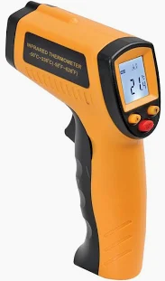
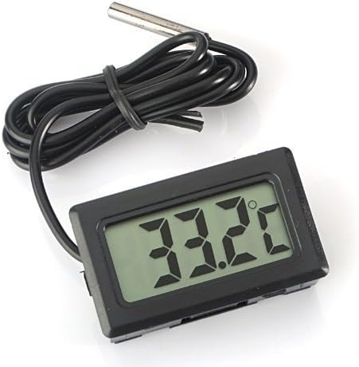
Equipment - Thermometer
Thermometers will measure the temperature for you. Some are dataloggers.
You could use an alcohol, digital or infrared thermometer.
Time will be needed to allow the thermometer to adjust to the air temperature

Slide 13
Can my school adapt to and resist a heatwave?
You are to collect temperature and light data around the external part of our school.
The goal is to see which areas would be most uncomfortable during a heat wave.
The types of micro - environments and surfaces where you should measure are shown in the table.
You should attempt to take your measurements as near as possible to some or all of these features.
Temperature/ light measurement | 1 | 2 | 3 | 4 | 5 | Mean
Astroturf
The ground shaded by a tree
Grass
Water features like ponds
Tarmac
Building colour - DARK
Building colour - LIGHT
Air conditioning units (outside part – Infrared thermometer only)
Door exits with heating units above

Slide 14
Task - Can my school adapt to and resist a heatwave?

Slide 15
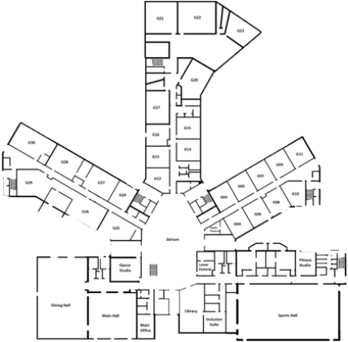
Can my school adapt to and resist a heat wave? Produce a sampling plan!
In pairs you need to produce a sampling plan.
Consider carefully WHERE you will collect your data and HOW. Which sampling strategy will you use? Why?
What equipment will you need?
How many measurements will you make in each location?
Draw your locations onto the school map.
The plan should ensure that your data collected is reliable and representative.
PRESENT your plan to another pair
N
Place a plan of your school above!

Slide 16
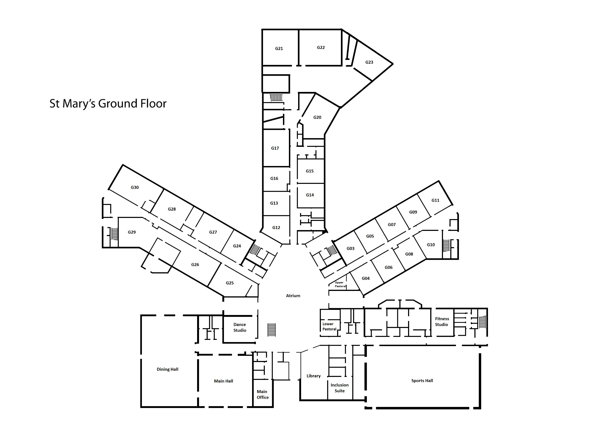
Writing Frame
Label your data collection points onto the map!
N
We will collect out data in the following places…
We will use a …..sampling strategy.
We selected this type of sampling because…...
The equipment we will use includes…
We will collect…measurements in each location. This is because….
Our data collection plan is reliable and representative because….

Slide 17
REVIEW - On the map of the school site where would you collect data on extreme heat using temperature, and light levels? Why?
N

Slide 18
Writing up your data

Slide 19
Can my school adapt to and resist a heatwave? Heatwave Fieldwork: Around the School Grounds
Write about your results!
Remember to PEEL AS you go!
Points with numbers (Evidence)
Explanation
Links to other data sets/theory
Unusual results (Anomalies)
Specialist terms
Place a graph from the spreadsheets here. Or get the students to draw their graph on graph paper.

Slide 20
Can my school adapt to and resist a heatwave? Example write up.
Points with numbers (Evidence)
Explanation
Links to other data sets/theory
Unusual results (Anomalies)
Specialist terms

Slide 21
Review - In general, temperature measurements are made in the shade.
Why?
Why was that not appropriate for this fieldwork?
?

Slide 22
Review - Can your school adapt to and resist a heatwave?
Explain what you’ve discovered?
?

